Slide 1
MANOR PARK
A DESTINATION PARK FOR ALL

Slide 2
Manor park a destination park for all
General Timeline of Events
2001 - Town Meeting, Article Eighteen - voted to appropriate funding for “said land to be held under jurisdiction of the Parks & Recreation Commission for recreational purposes, which may include construction of recreational facilities . . .”
2001 - Annual Town Election, Article Eighteen – voted and passed
2003 - Town Meeting, FY 2004 Capital Improvement – voted to appropriate $300K for Striar Property Construction – feasibility study & engineering plan
2004 - Request for Proposal (RFP) - Volmer Associates feasibility study
2012 - Request for Proposal (RFP) – Activitas engineered plan
2014 - Engineered site plan approved through appropriate Town boards

Slide 3
Manor park a destination park for all

Slide 4
Manor park a destination park for all
Cost Overview
Total Cost @ $14.5mm
Average Annual Household Tax Bill Increase @ $81 (over 20 years)

Slide 5
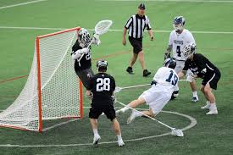
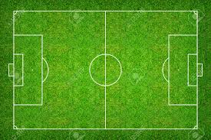
Manor park a destination park for all
Amenity – 2 Multi-Use Synthetic Turf Fields
lacrosse, soccer & football, field hockey - Lighted
. . . athletic fields in Dedham are over scheduled and overused compared to their capacity. . . natural grass fields need to be rested and allowed to recover . . .(DPRMP pg. 102 Needs Assessment)
Steps taken by DPR to renovate Gonzalez Field and the continued support of Manor Park (as planned) will go a long way in the support of rectangular multi-use field space . . . Dedham should have enough multi-use field space to support its programming in the future with the addition of Manor Park.
(DPRMP pg.104)
Boys and girls lacrosse are the fastest growing sport from a national and state perspective . . . (DPRMP pg. 100)

Slide 6
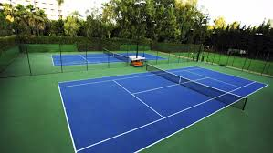
Manor park a destination park for all
Amenity – 4 Tennis Courts
Lighted
Tennis courts were lost due to the development of the Dedham Middle School . At that time the School Building and Rehabilitation Committee had promised to replace the courts but it never came to fruition.
At one time Dedham had 13 tennis courts. We currently have 3!

Slide 7
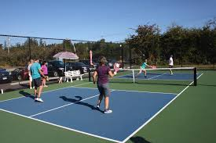
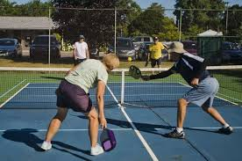
Manor park a destination park for all
Amenity – Pickleball Courts
Lighted
Ensure equitable recreation experiences for the diverse community. (DPRMP pg. 111 Goals)
Based on the Single Sport Participation Report of the Sports & Fitness Industry Association (SFIA) on Pickleball, 75% of core players are 55 and older.
Pickleball is one of the fastest growing sports in the United States.
A new Western State Colorado University study of 15 middle-aged and older adults found that regular pickleball playing — in this case three times a week for one hour for six weeks — resulted in improved blood pressure and cardiorespiratory fitness.

Slide 8
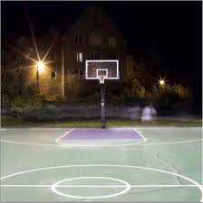
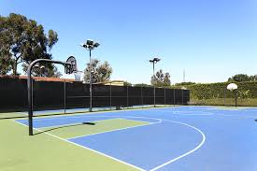
Manor park a destination park for all
Amenity – 2 Basketball Courts
Lighted
Basketball courts were lost due to the development of the Avery Elementary School. At that time, the School Building and Rehabilitation Committee had planned to replace the courts but it never came to fruition.

Slide 9
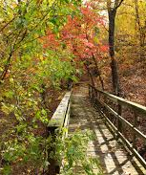
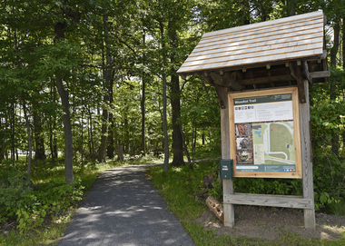
Manor park a destination park for all
Amenity – Nature Trails
1.5+ miles of nature trails
Improve opportunities to experience nature.
(DPRMP pg. 116 Recommendations)
. . . walking trails were one of the most popular forms of recreation and requested amenities on the public survey. (DPRMP pg.133)
. . . residents would like to see more use of parks and open space for environmental education, programming and wildlife exploration opportunities.
(DPRMP pg. 95)

Slide 10
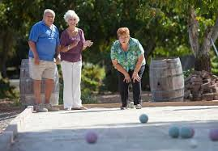
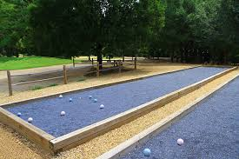
Manor park a destination park for all
Amenity – 2 Bocce Courts
Ensure equitable recreation experiences for the diverse community.
(DPRMP pg. 111 Goals)
Benefits of bocce are numerous; light cardio, better flexibility, social activity, improved coordination, relieves stress, increases confidence and promotes outdoor time.

Slide 11
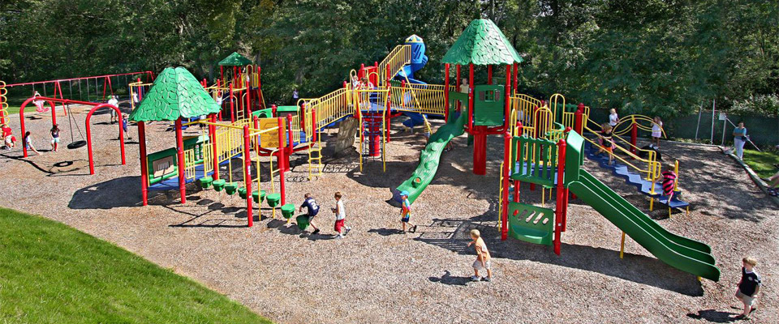
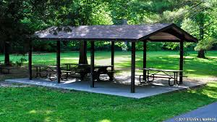
Manor park a destination park for all
Amenity – Playground, Picnic Areas
Expand places for children to play.
(DPRMP pg. 116 Recommendations)
. . . add new and varied play areas and equipment. (DPRMP pg.116)
. . . amenities such as picnic areas, restrooms and shelters . . . are areas which DPR can improve.
(DPRMP pg. 98)

Slide 12
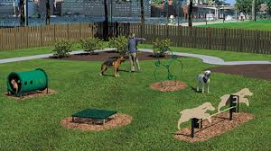
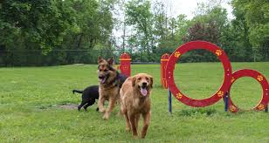
Manor park a destination park for all
Amenity – 2 Dog Parks
1for smaller breeds, 1 for medium to larger breeds
At the time of construction, the Dog Park at the Dolan Center was to be a temporary solution for an immediate need.
Now that we’ve seen the growth and popularity of the Dolan Dog Park, we intend to offer the same service in this part of the community.

Slide 13
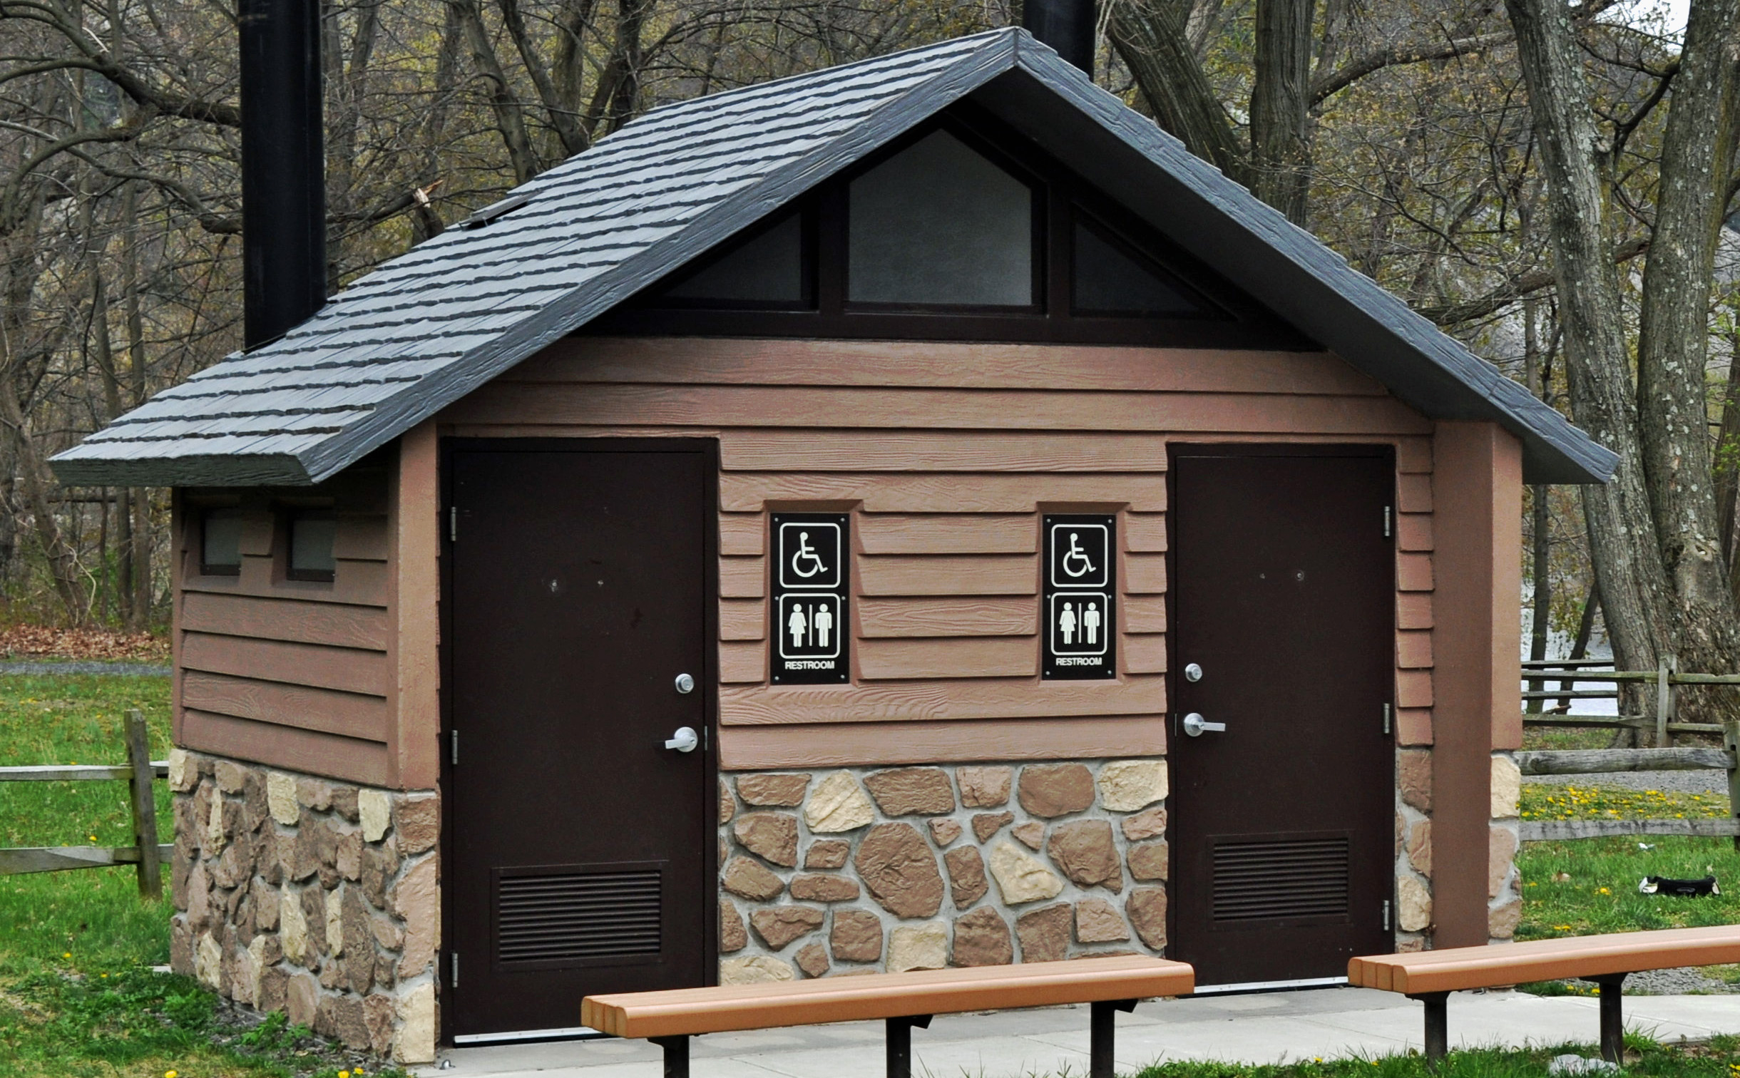
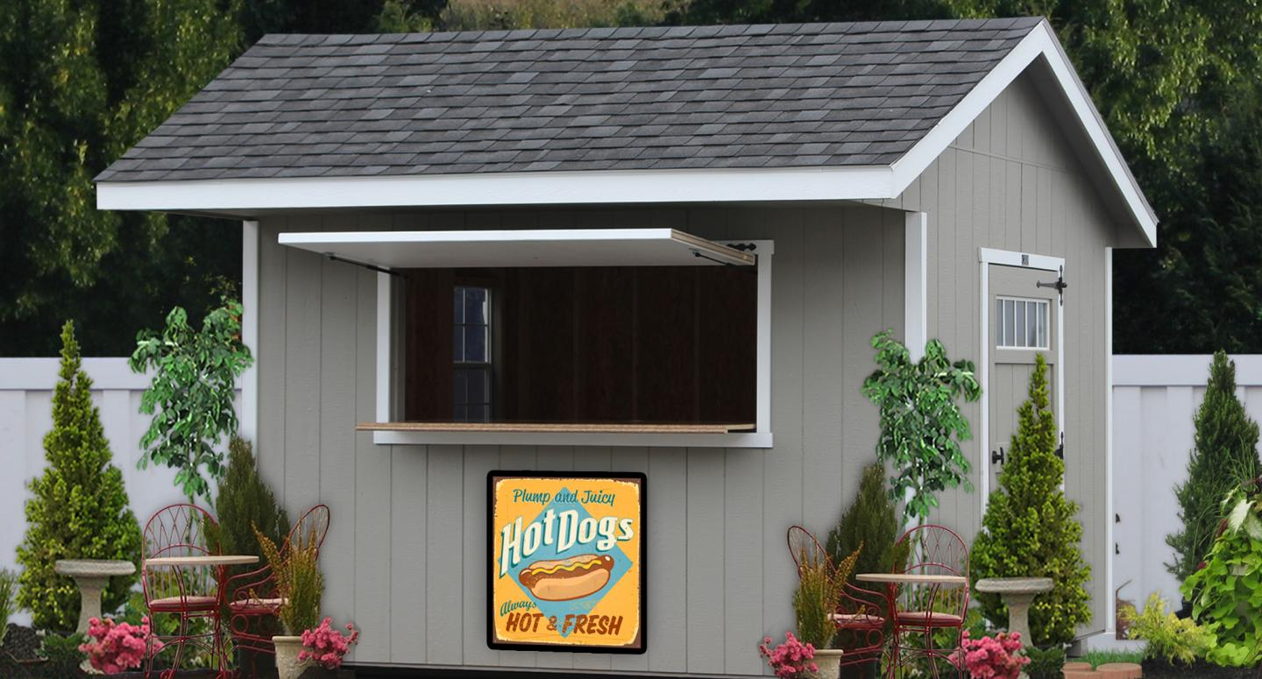
Manor park a destination park for all
Concession Stand, Restrooms
Manor Park is designed to be a complete destination park with amenities built to serve the entire community. Further, it will have a concession stand and inclusive restrooms.

Slide 14
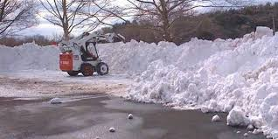
Manor park a destination park for all
Snow Dumping Relief
Manor Park is designed to accommodate overflow snow dumping in case the currently used facilities are filled throughout the winter season.

Slide 15
Manor park a destination park for all
We respectfully ask for your support so that a project of this scope and importance is able to be decided by a Town wide vote.

