Slide 1
SCHOOL Facilities Department FY18 Capital Budget Request Capital Expenditures Committee
Presented by: Denise Moroney, Director of Facilities, 1/23/2017

Slide 2
FY18 Capital Budget Development
STEPS TO DEVELOPING FY18 SCHOOL CAPITAL BUDGET:
1. October 2016– met with each school Principal and Special Education Director to discuss building needs
2. Reviewed list of 63 project requests with Mike Welch and Sam Rippin to determine highest needs
3. Met with vendors to obtain quotes for newly added projects
4. Attended School Committee (SC) Budget Subcommittee meeting on 11/15/16 to introduce list of 17 projects reduced to 15 projects
5. Reviewed project listing with Mike Welch and Sam Rippin and adjusted requested amounts as needed
6. Reviewed prioritized list of 15 projects with SC Budget Subcommittee on 11/30/16 – Approved
7. Capital Expenditures Committee meeting on 1/23/2017
8. FINCOM meetings to be scheduled

Slide 3
FY18 School Capital Request
1 – HVAC RTU Replacements $200,000
2 – Auditorium Asbestos Fire Curtain $70,000
3 – Asphalt Resurfacing $235,918
4 - Kitchen Dishwasher System $75,000
5 - School Field Fencing $30,000
6 - Playground ADA Improvements $100,000
7 - Exterior Doors $75,000
8 - Floor Tile Asbestos Abatement $75,000
9 - Shade Replacements $35,000
10 - Library Renovations – Schematic Design $30,000
11 - Wood Shop - Schematic Design $30,000
12 - Bathroom Renovations $50,000
13 - Reimbursable Energy Efficient Lighting $50,000
14 - Multi Function School Activity Bus $60,000
Subtotal Projects 1-14: $1,115,918
Note: Removed $25,000 DHS Auditorium Stage Lighting & $500,000 for Greenlodge Windows

Slide 4
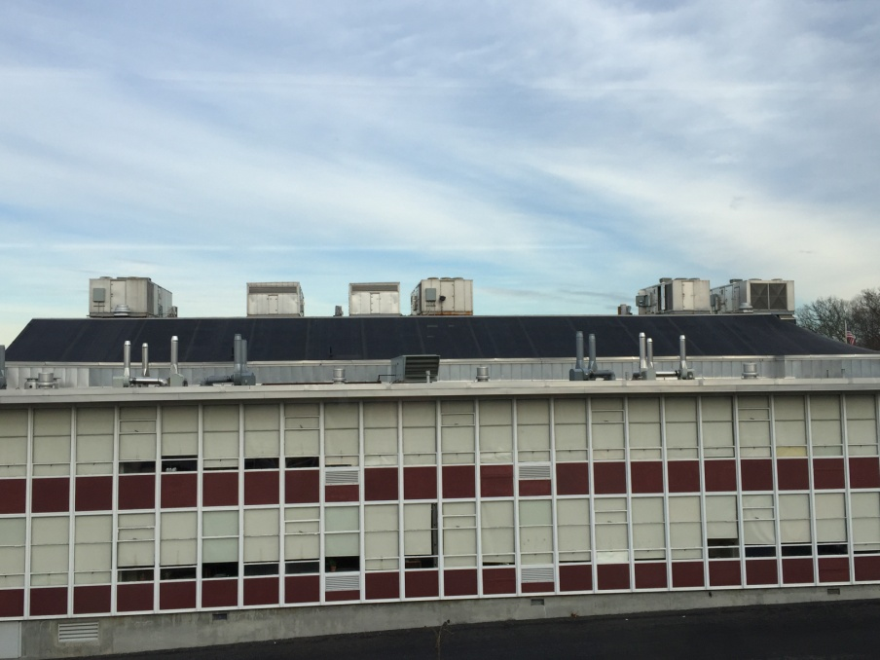
1.HVAC RTU Replacements
1
2
3
4
5
6
Six (6) HVAC Rooftop units installed in 1999, or 17 years old – useful life is 15 years – replace one (1) per year over next 6 years
RTUs provide heat, air conditioning and outside air/ventilation to the cafeteria, kitchen and interior classrooms

Slide 5
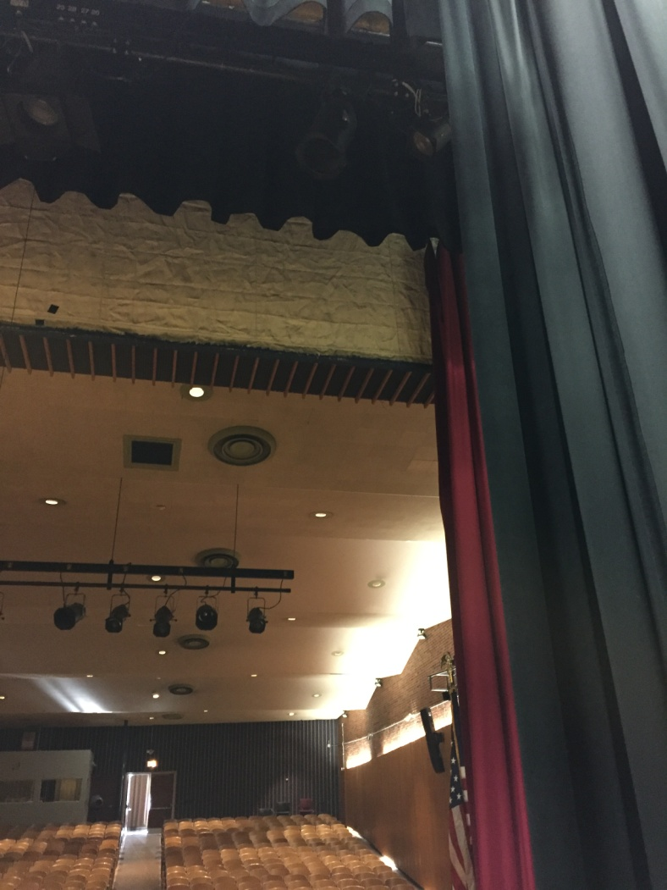
2.Auditorium Asbestos Fire Curtain
DHS Auditorium Stage asbestos fire curtain
- needs to be removed and replaced per building code due to building not having sprinklers

Slide 6
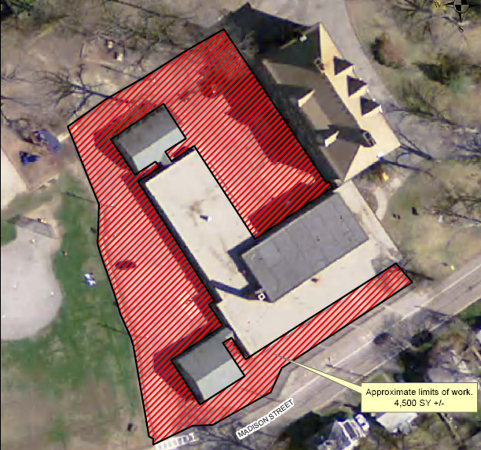
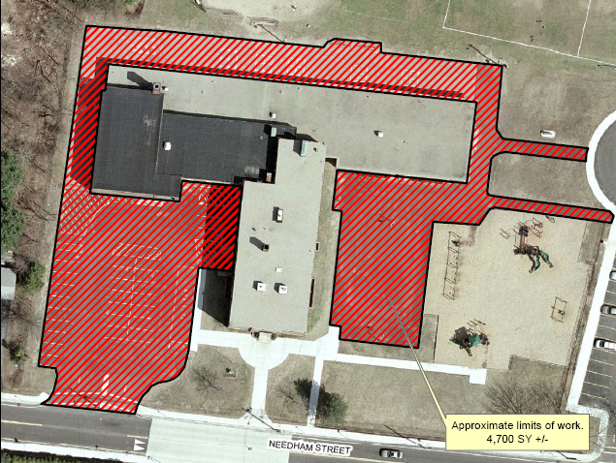
3.Asphalt Resurfacing
Oakdale 4500 SY – LoRusso Bid $113,228
Riverdale 4700 SY– LoRusso Bid $122,690

Slide 7
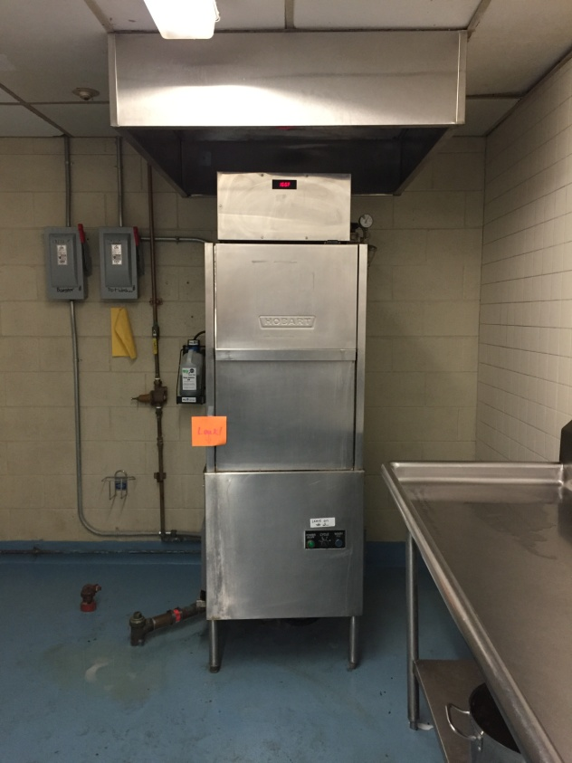
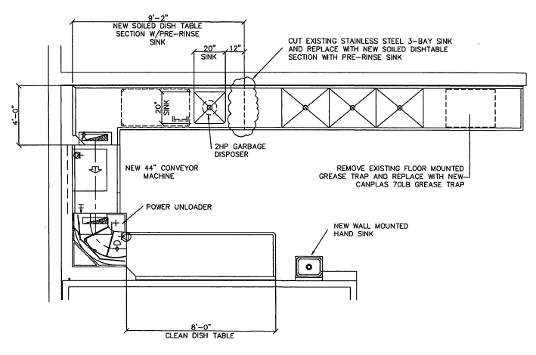
4.Kitchen Dishwasher System
*Recycling Program: Replacing styrofoam trays with reusable trays that need to be washed which is not possible with the current dishwasher
Current Dishwasher
New Proposed Dishwasher Layout

Slide 8
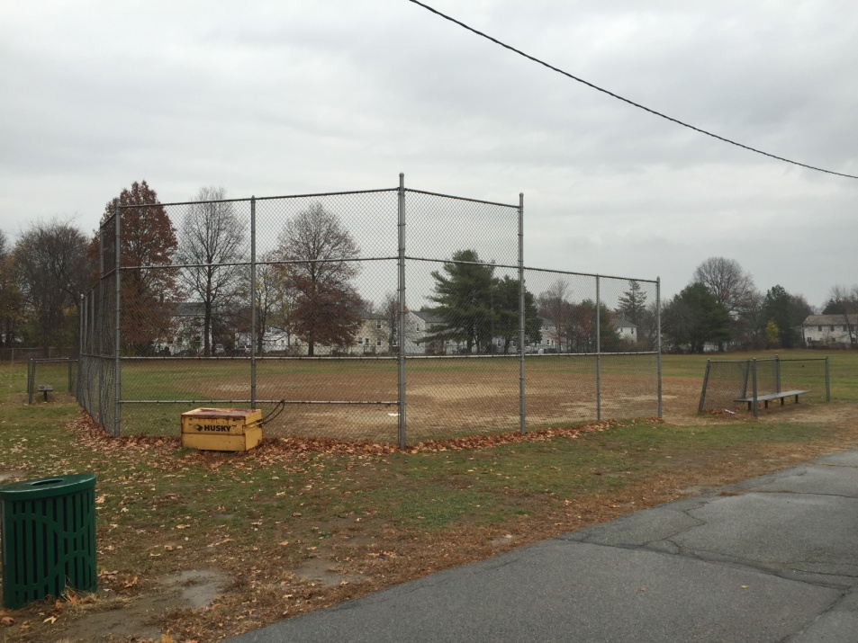
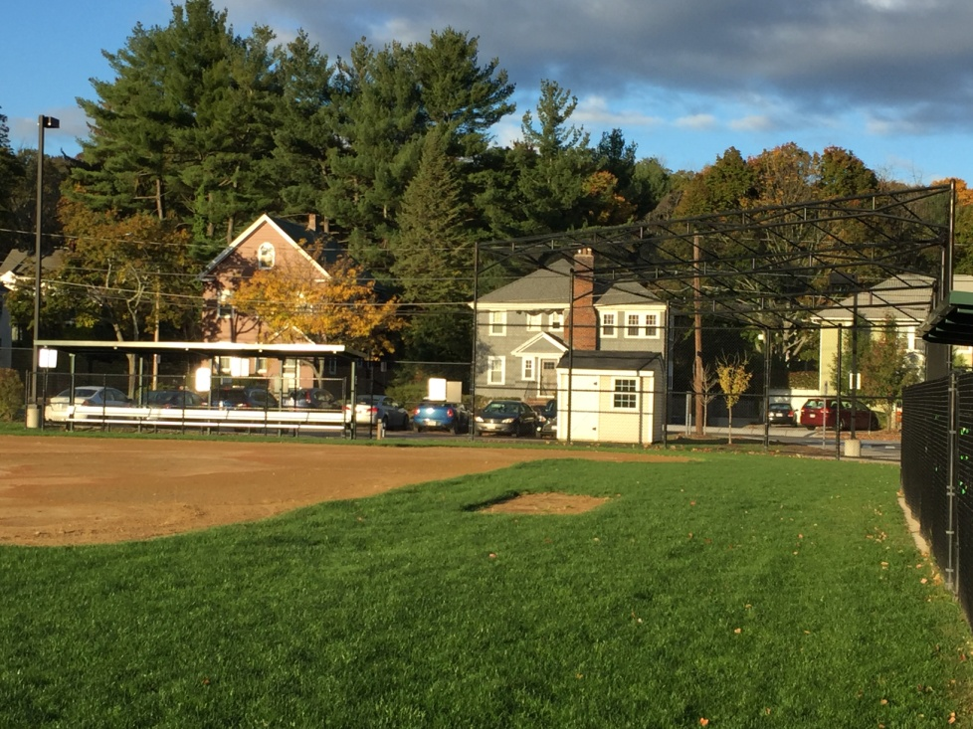
5.School Field Fencing
* School Fields – Replace backstop and team bench fencing to improve safety
Riverdale School Field Backstop
Newton North High School Backstop

Slide 9
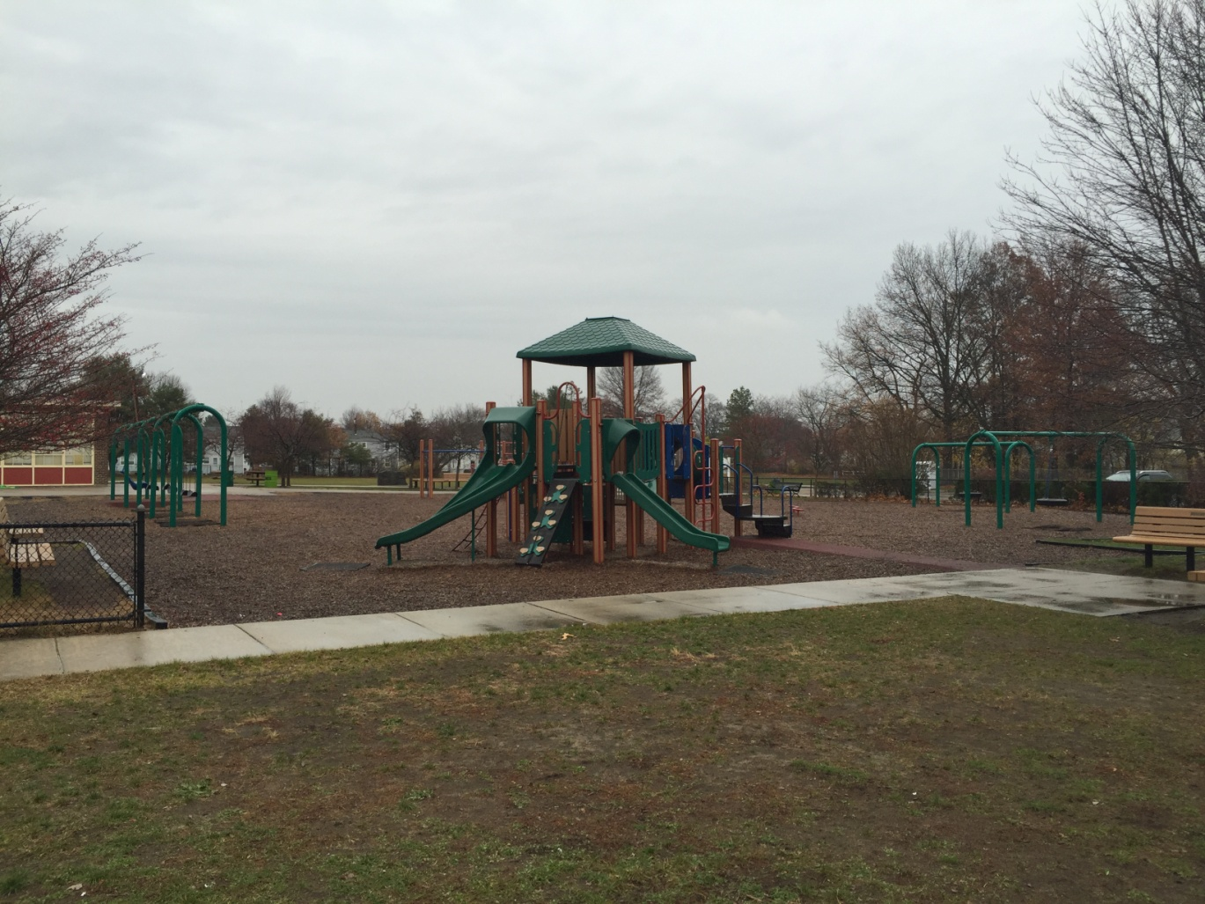
6.Playground ADA Improvements
* Riverdale Playground – Poured In Place surfacing needed for accessibility as wood fiber is an unstable surface for impaired students

Slide 10
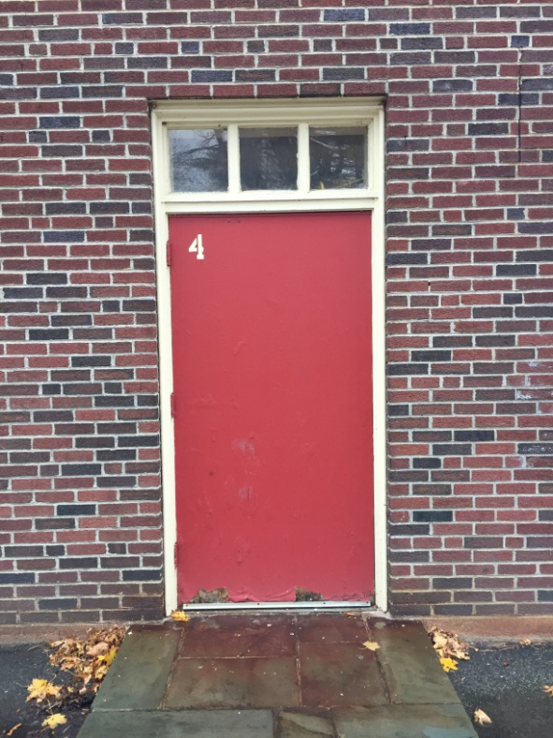
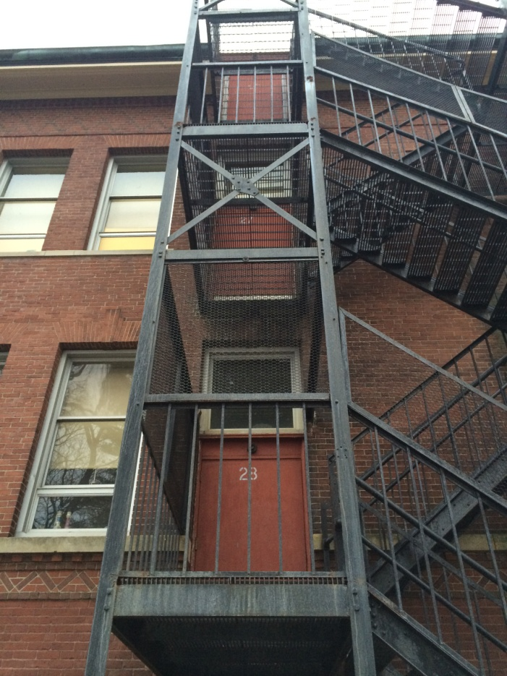
7.Exterior Doors
Riverdale – replace gym doors #4 & #5
Oakdale – replace fire escape doors

Slide 11
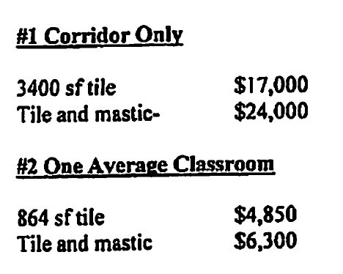
8.Floor Tile Asbestos Abatement

Slide 12
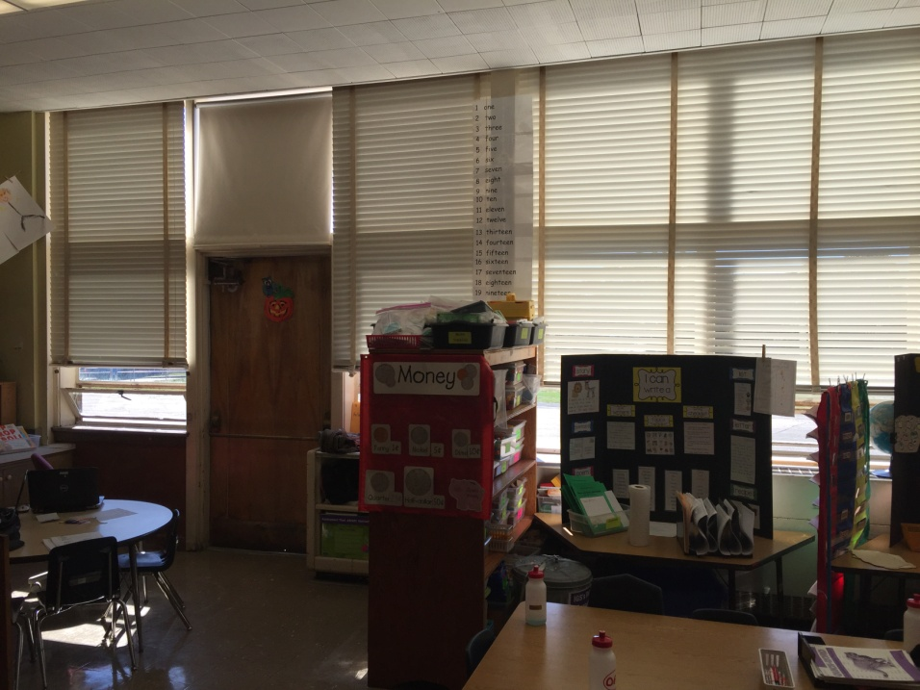
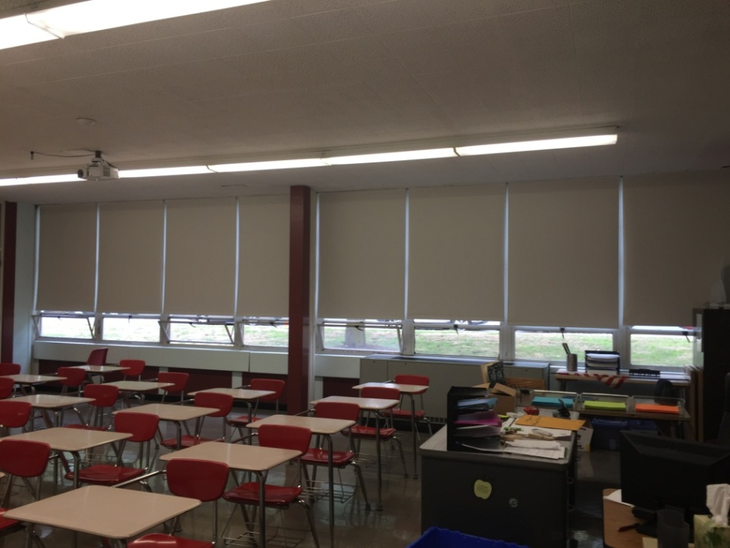
9.Shade Replacement
Improved learning with no daylight to properly use projectors on whiteboards
Continue shade replacement program at Oakdale
Oakdale Classroom with Blinds
DHS Classroom with New Room Darkening Shades

Slide 13
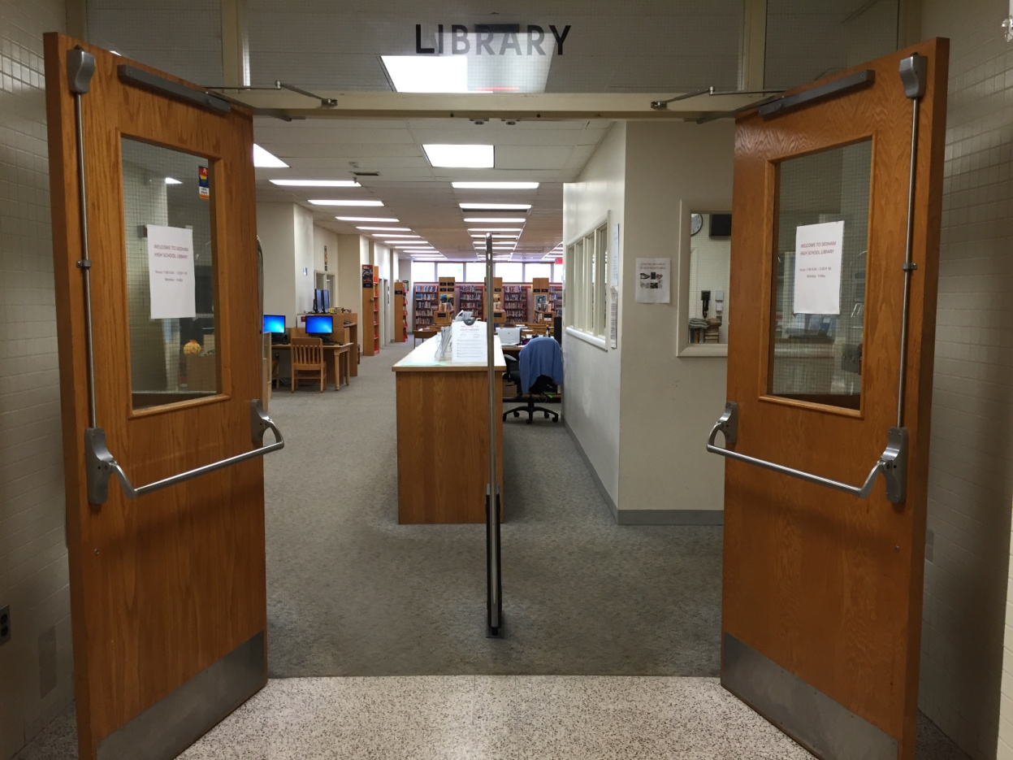
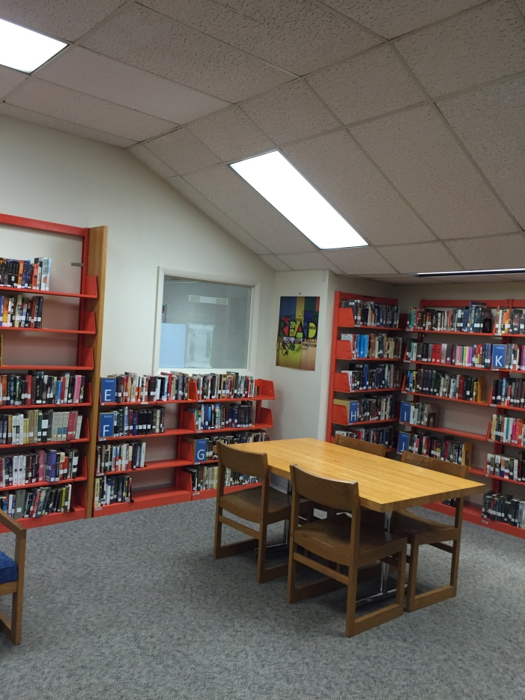
10.Library Schematic Design
Schematic Design funds for library renovated to meet current technology
needs and create space for collaborative project work

Slide 14
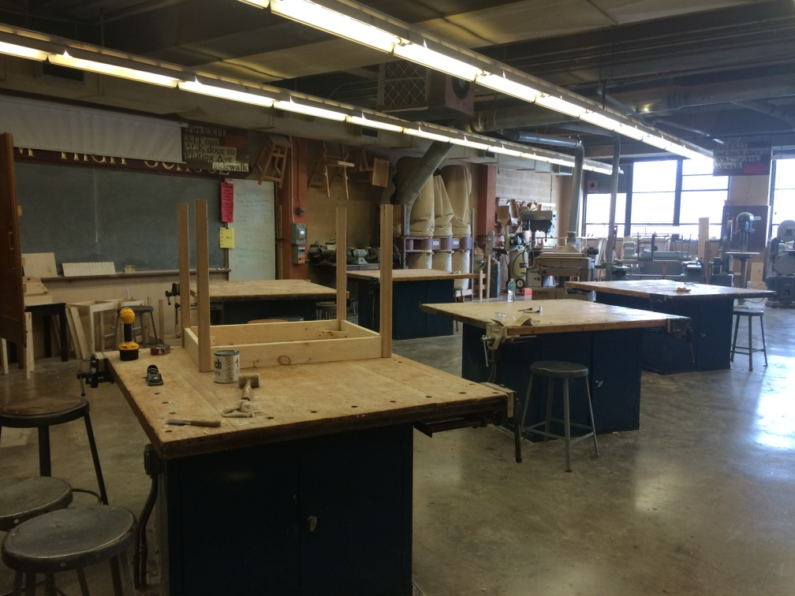
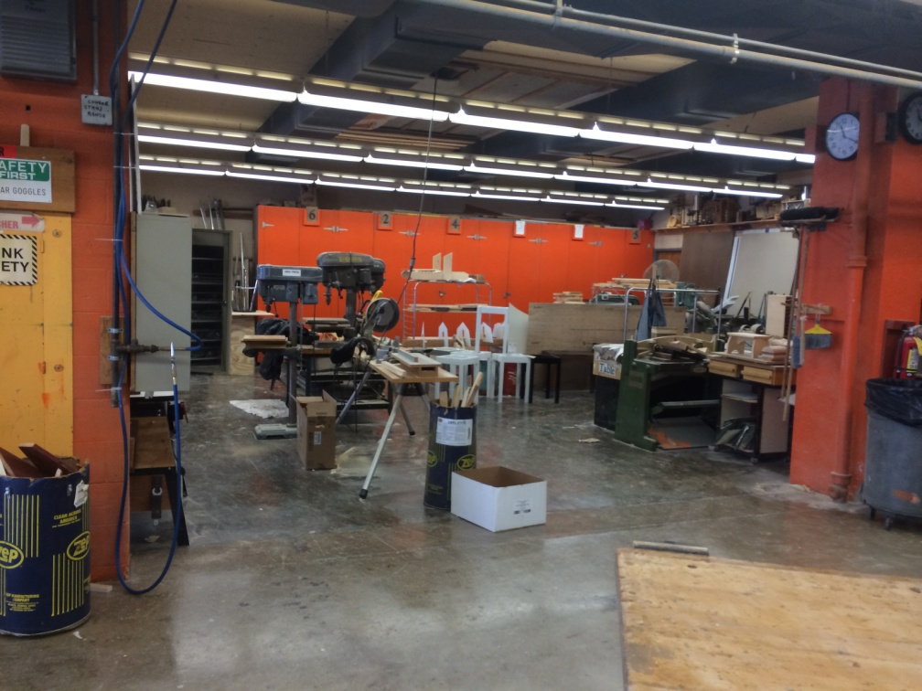
11.Wood Shop Schematic Design
Schematic Design funds for wood shop renovation to improve dust collection and air filtration system to improve safety and build out a “design center” with a climate controlled classroom space

Slide 15
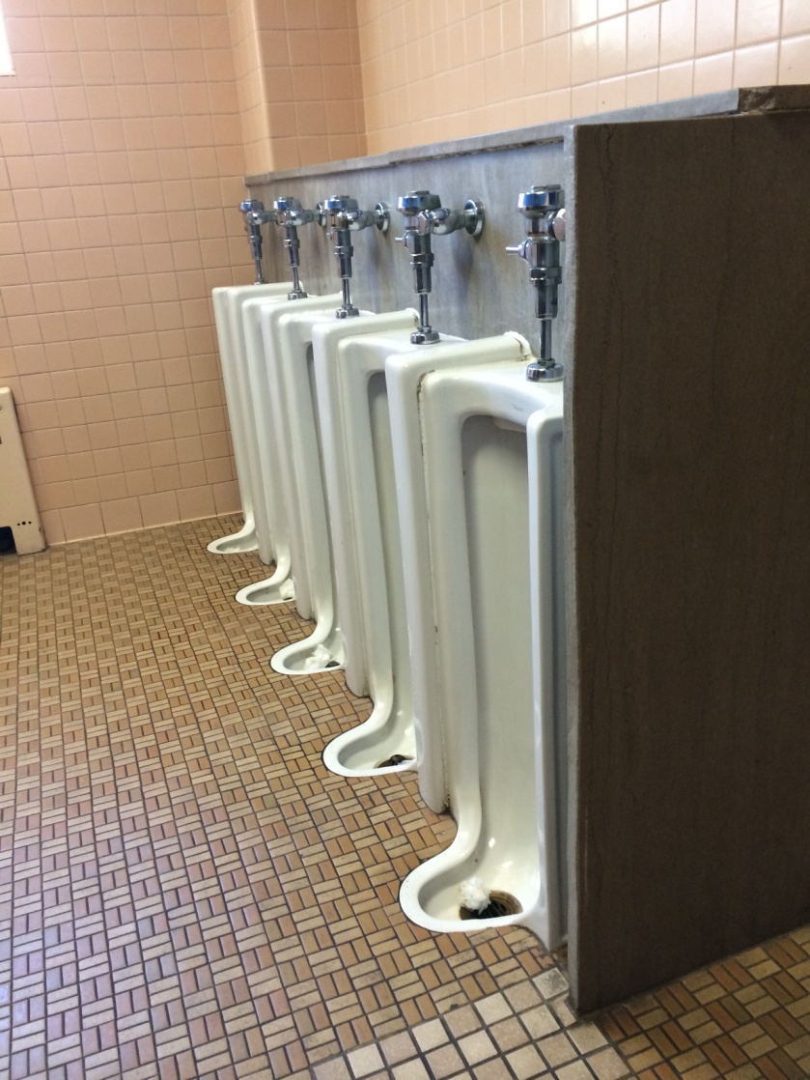
12.Bathroom Renovations
Riverdale Urinals – need to be removed, floor repaired and new urinals/plumbing installed
Children urinate on floor due to built in design of older urinals - unsanitary and maintenance issue

Slide 16
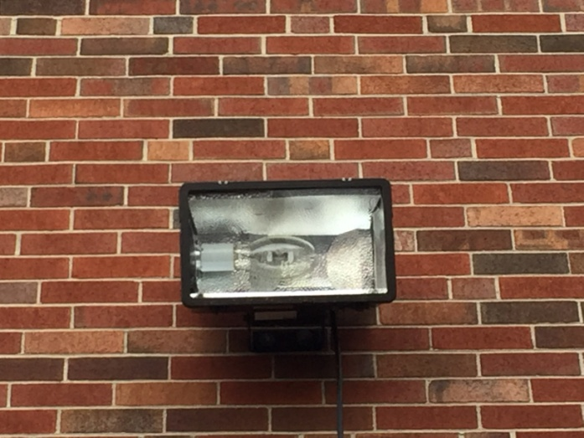
13.Energy Efficient Lighting
Replace 400 watt exterior flood lights with 200 watt LED lamps – energy savings PLUS maintenance efficiency due to long life and safety improvements

Slide 17
14.Multi Fx School Activity Bus
14 seat capacity
Smaller athletic teams i.e. tennis, freshmen teams, golf
Life skills travel to job sites
Debate team, Math team, Robotics team
Parks and Rec summer program during July and August

Slide 18
Facilities Staff -Contact Info
QUESTIONS?
Please feel free to contact the Facilities & Maintenance Department staff:
Denise Moroney, Director of Facilities
781-310-1141 office
781-752-7812 cell
Email: dmoroney@dedham.k12.ma.us
Roger Lazdowsky, Facilities Operations Supervisor
781-310-1168 office
781-801-6825 cell
Email: rlazdowsky@dedham.k12.ma.us
Barbara Smith, Facilities Clerk
781-310-1220 office Email: basmith@dedham.k12.ma.us

