Slide 1
Dedham Facilities & Maintenance Department FY18 TOWN CAPITAL REQUEST
Prepared By: Denise Moroney,
Director of Facilities
January 23, 2017

Slide 2
FY18 Capital Request - Town Projects
FY18 TOWN FACILITIES - CAPITAL BUDGET REQUEST = $571,455
1. POOL IMPROVEMENTS $270,00
2. MAIN & ENDICOTT LIBRARY FLOORING $100,000
3. VEHICLE REPLACEMENTS $91,455
4. ENDICOTT PORCH REPAIRS $50,000
5. ENDICOTT PAINTING & REPAIRS $50,000
6. MEMORIAL FIELD CONCESSION STAND IMPROVEMENTS $10,000

Slide 3
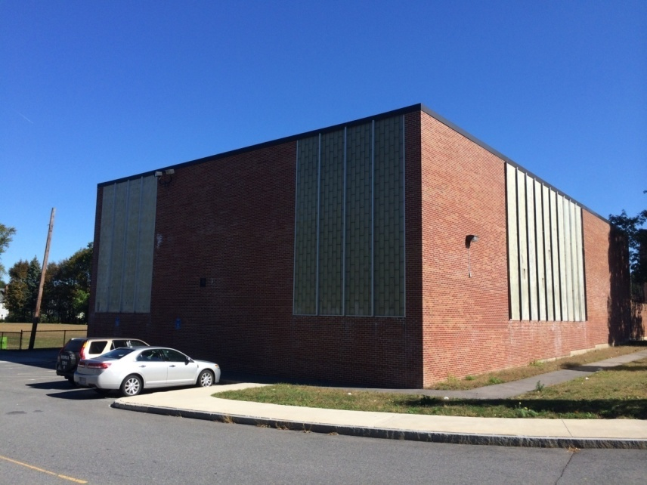
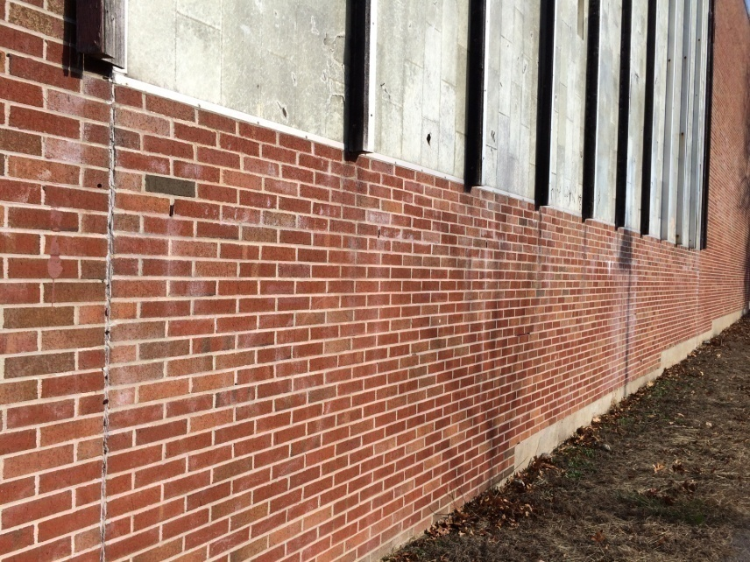
FY18 Capital Request - Town Projects
POOL IMPROVEMENTS -
REPLACE WINDOWS/MASONRY REPAIRS /DOORS $270,000

Slide 4
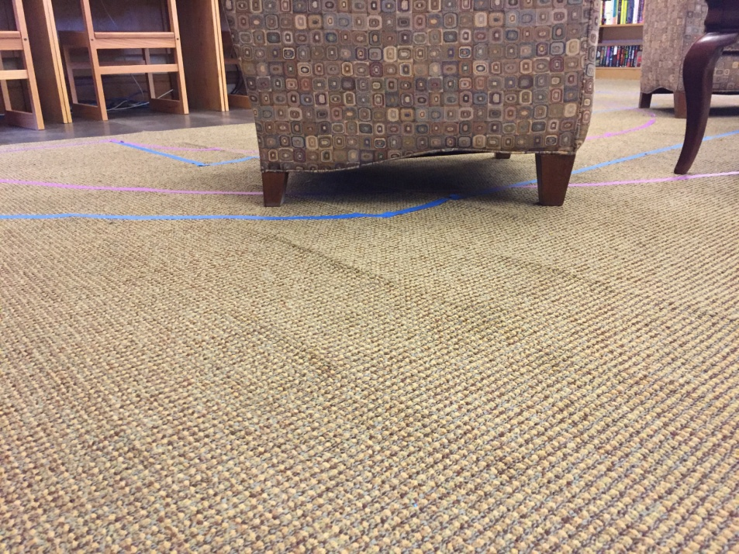
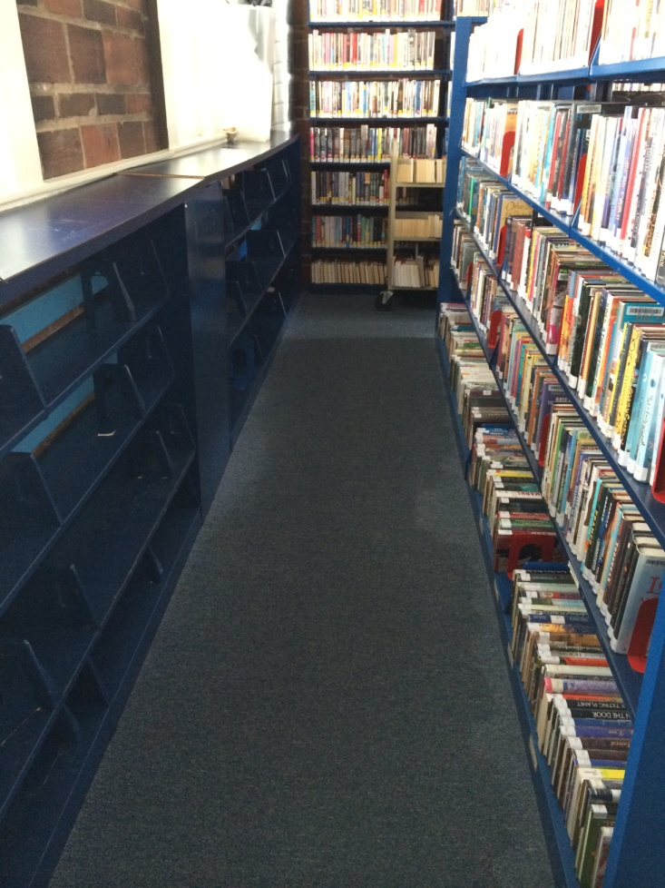
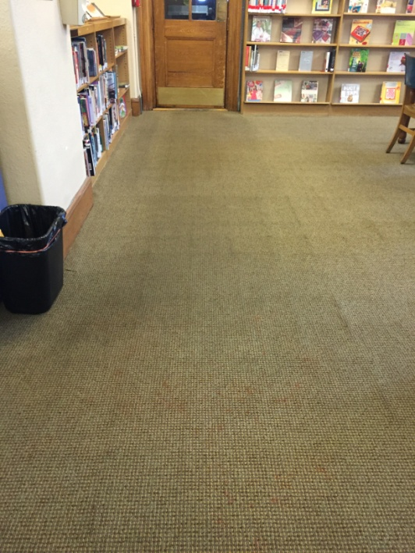
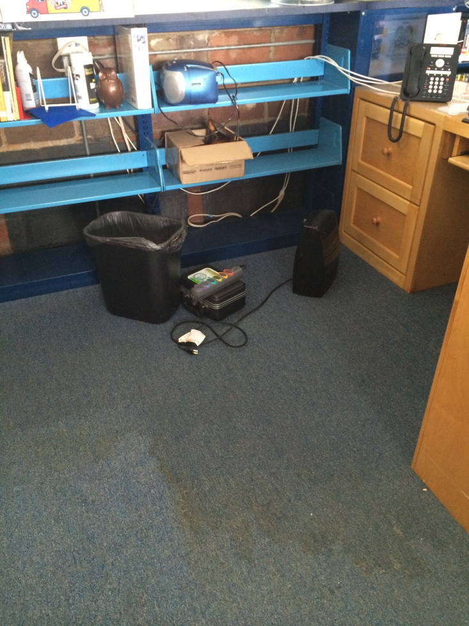
FY18 Capital Request - Town Projects
2. MAIN AND ENDICOTT LIBRARY - NEW FLOORING $100,000

Slide 5
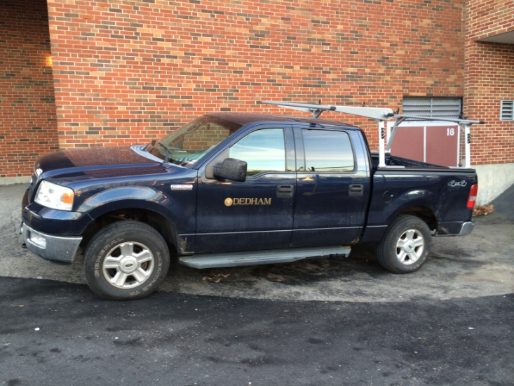
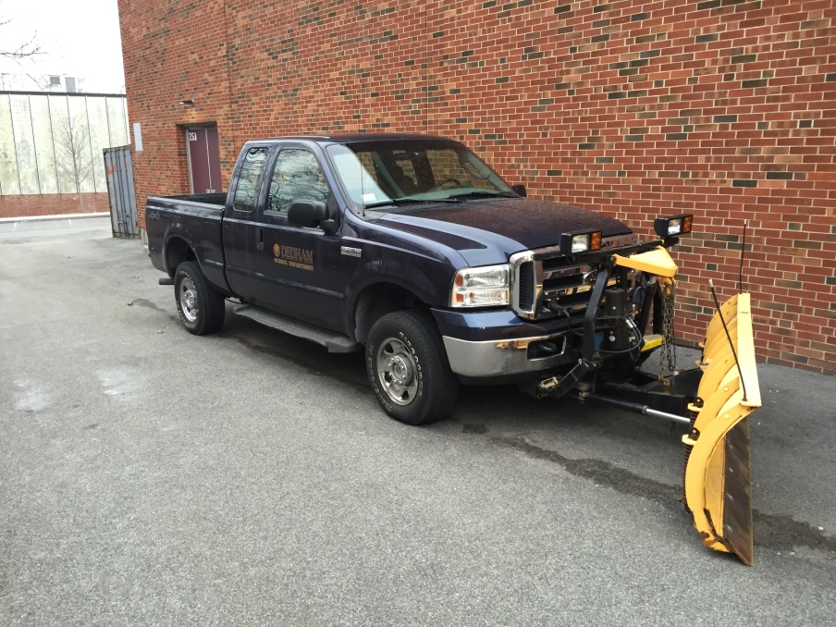
FY18 Capital Request - Town Projects
3. VEHICLE REPLACEMENTS (2) -
SAFETY GOAL COMPLETE: NO VEHICLE OVER 10 YEARS OLD $91,455
2004 Ford F150 Crew Cab – 13 years old
Replace with new FORD TRANSIT CARGO XL
2006 Ford F250 with 8’ plow – 11 years old
Replace with new FORD F250 and 8’ plow

Slide 6
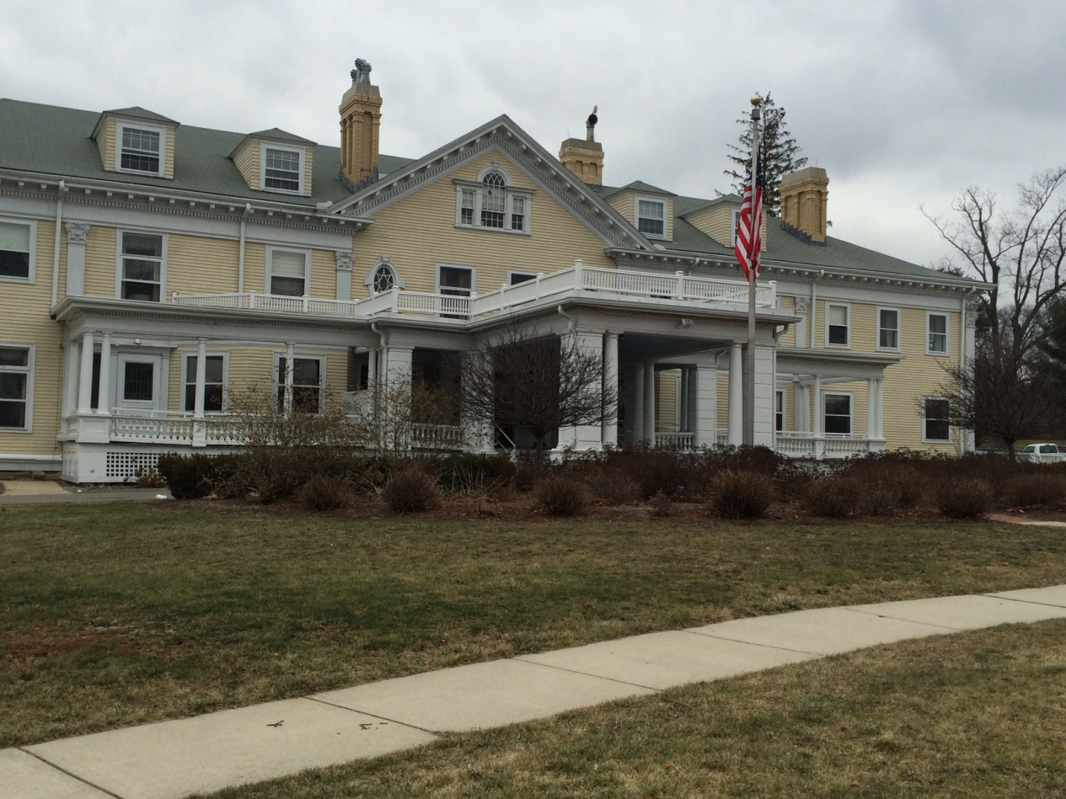
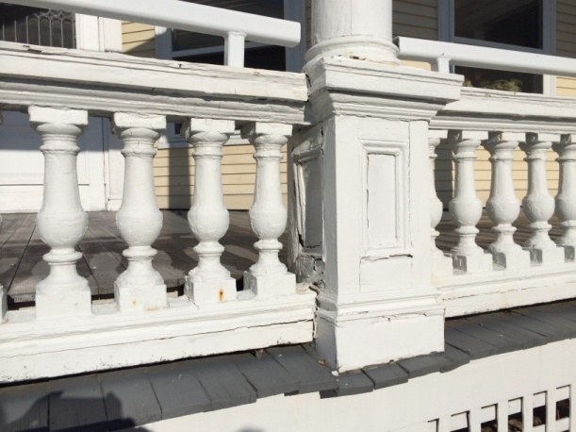
FY18 Capital Request - Town Projects
4. ENDICOTT PORCH
BID AWARD,
HISTORICAL DESIGN &
UNKNOWN STRUCTURAL
ISSUES $50,000

Slide 7
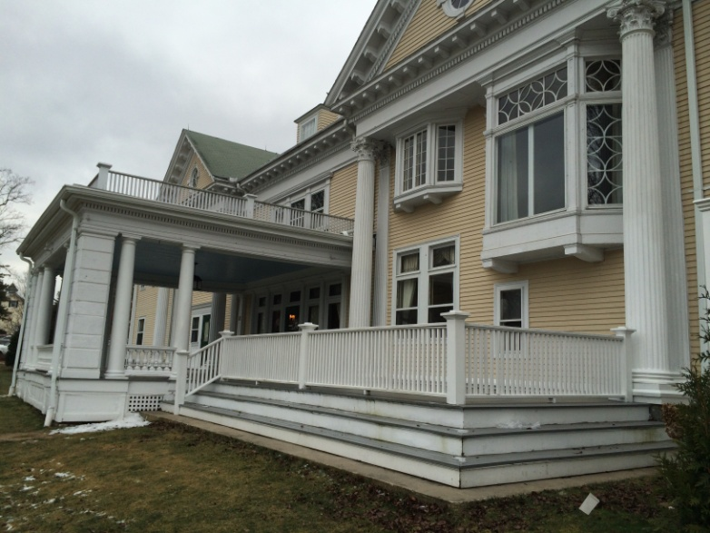
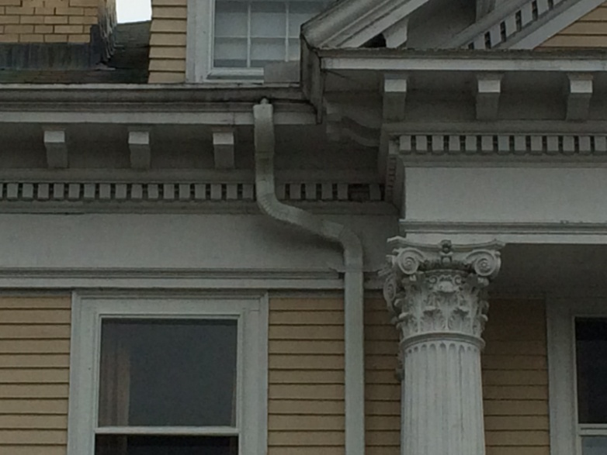
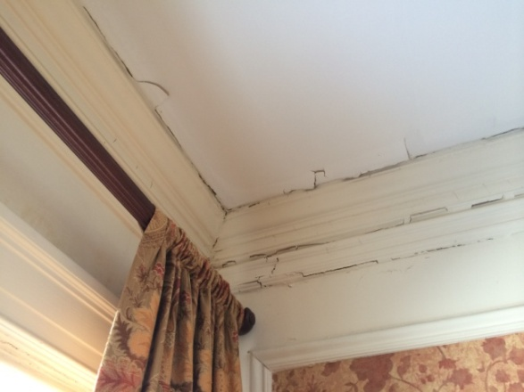
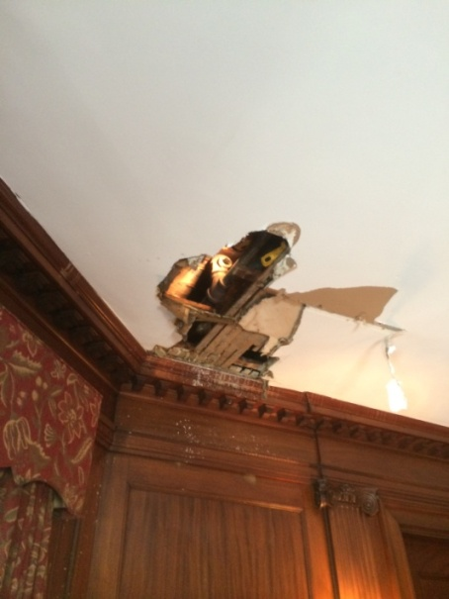
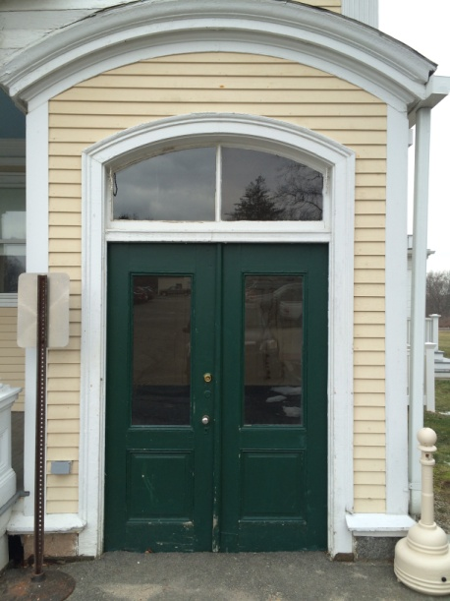
FY18 Capital Request - Town Projects
5. ENDICOTT PAINTING & REPAIRS $50,000

Slide 8
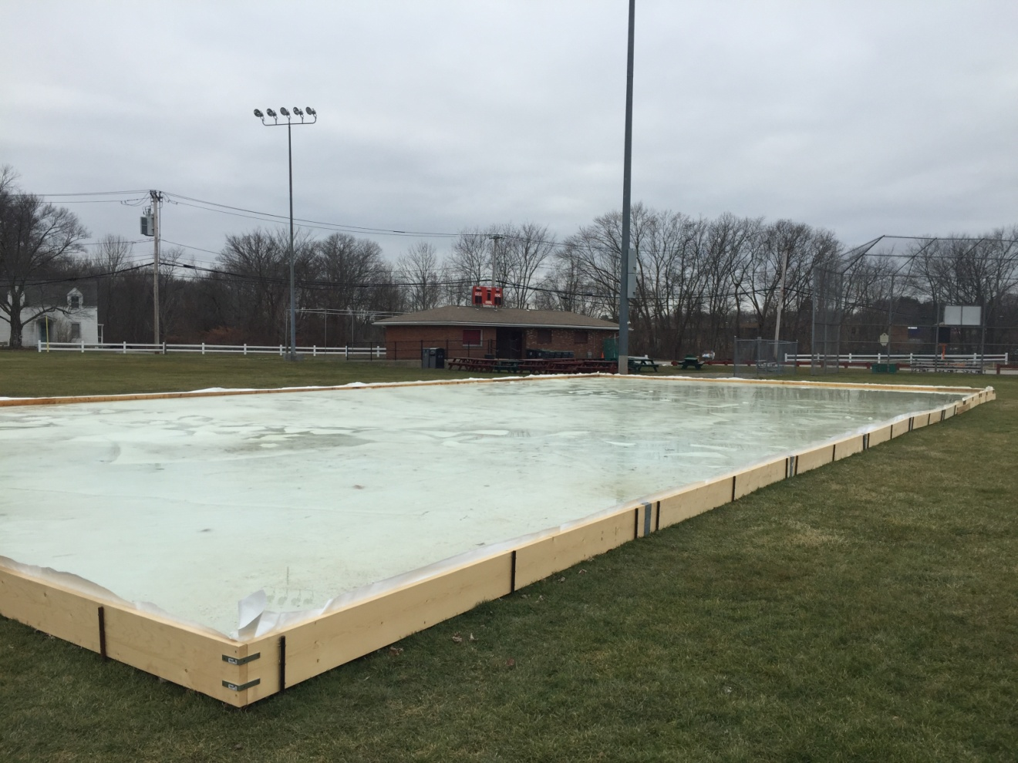
FY18 Capital Request - Town Projects
6. MEMORIAL FIELD -
CONCESSION STAND IMPROVEMENTS $10,000 HEAT & WINDOWS

