Slide 1
An Investment In Our Community
The CPA is an investment that pays big returns back to taxpayers
The money collected in the surcharge is effectively guaranteed a positive return
In the last 7 years the average annual return would have been 39 cents on the dollar!!
Unlike an investment, this is money we MUST and will spend anyway on capital projects
Unlike an investment there is no way to lose money, some positive return is assured by program

Slide 2
Community Preservation Act (CPA)
Take Home Message:
If Dedham had passed a 1% CPA in 2003 the town would have raised over 6 million dollars for Town Meeting-approved projects that would NOT have come from residential taxpayers with almost 4 million coming from the CPA trust fund.
During a time when the town spent tens of millions on potential CPA projects, we did not take advantage of millions in state dollars, costing Dedham taxpayers millions.

Slide 3
What A Yes Vote On Article 12 Means
A Yes Vote On Article 12 does NOT make the CPA law
A Yes Vote On Article 12 allows the CPA to go to town wide ballot question to let voters decide in April on the proposal

Slide 4
CPA What is it? How does it work? (cont.)
A 1% surcharge is applied to residential and commercial real property.
First $100,000 of value of residential and class 3 commercial property is exempt.
Existing property tax exemptions (value, income, etc.) apply proportionally.
Revenues go into the CPA fund; state trust fund distribution to Dedham is a percentage of that amount.
Early trust fund distributions were 100% - recent distributions have been 30-50%

Slide 5
CPA Funds
The CPA trust fund is funded by county registry fees and distributed by the State.
Dedham paid about 95,000 in registry fees last year.
Our distribution would have been about $230,000.
Our fees went to benefit other communities that participate in CPA.

Slide 6
CPA What is it? How does it work? (cont.)
Community Preservation Act (CPA)
2003-2016 Total Estimates
CPA ESTIMATES - ALL RESIDENTIAL
YEAR | PARCEL COUNT | TOTAL RES VALUE | AVERAGE RES VALUE | RES TAX RATE | AVG RES TAX BILL | RES EXEMPTION | AVG RES CPA VALUE | CPA | AVG CPA SURCHARGE | TOTAL AVG RES TAX BILL | TOTAL LOCAL SURCHARGE | PERCENT MATCH | STATE MATCH | TOTAL REVENUE RAISED
2003 | 7,608 | $1,830,696,700 | $240,628 | $14.03 | $3,376.01 | $100,000 | $140,628 | 1% | $19.73 | $3,395.74 | $150,106.51 | 100.00% | $150,106.51 | $300,213.01
2004 | 7,619 | $2,767,843,141 | $363,282 | $10.23 | $3,716.37 | $100,000 | $263,282 | 1% | $26.93 | $3,743.31 | $205,207.98 | 100.00% | $205,207.98 | $410,415.97
2005 | 7,660 | $2,958,984,901 | $386,290 | $10.48 | $4,048.32 | $100,000 | $286,290 | 1% | $30.00 | $4,078.33 | $229,824.82 | 100.00% | $229,824.82 | $459,649.64
2006 | 7,735 | $3,132,554,025 | $404,984 | $11.15 | $4,515.58 | $100,000 | $304,984 | 1% | $34.01 | $4,549.58 | $263,034.52 | 100.00% | $263,034.52 | $526,069.05
2007 | 7,755 | $3,513,713,380 | $453,090 | $10.93 | $4,952.27 | $100,000 | $353,090 | 1% | $38.59 | $4,990.87 | $299,286.72 | 100.00% | $299,286.72 | $598,573.44
2008 | 7,798 | $3,310,207,580 | $424,494 | $12.05 | $5,115.16 | $100,000 | $324,494 | 1% | $39.10 | $5,154.26 | $304,914.11 | 100.00% | $304,914.11 | $609,828.23
2009 | 7,813 | $3,301,416,561 | $422,554 | $12.62 | $5,332.63 | $100,000 | $322,554 | 1% | $40.71 | $5,373.34 | $318,038.71 | 67.62% | $215,057.78 | $533,096.49
2010 | 7,840 | $3,187,818,600 | $406,610 | $13.57 | $5,517.69 | $100,000 | $306,610 | 1% | $41.61 | $5,559.30 | $326,198.18 | 34.81% | $113,549.59 | $439,747.77
2011 | 7,854 | $3,173,267,899 | $404,032 | $14.37 | $5,805.94 | $100,000 | $304,032 | 1% | $43.69 | $5,849.63 | $343,136.62 | 27.20% | $93,333.16 | $436,469.78
2012 | 7,858 | $3,075,857,367 | $391,430 | $15.43 | $6,039.77 | $100,000 | $291,430 | 1% | $44.97 | $6,084.73 | $353,355.85 | 26.64% | $94,134.00 | $447,489.85
2013 | 7,868 | $3,101,787,227 | $394,228 | $15.79 | $6,224.86 | $100,000 | $294,228 | 1% | $46.46 | $6,271.32 | $365,536.48 | 26.83% | $98,073.44 | $463,609.92
2014 | 7,885 | $3,152,298,800 | $399,784 | $16.08 | $6,428.53 | $100,000 | $299,784 | 1% | $48.21 | $6,476.74 | $380,098.85 | 52.22% | $198,487.62 | $578,586.46
2015 | 7,903 | $3,298,253,981 | $417,342 | $15.87 | $6,623.22 | $100,000 | $317,342 | 1% | $50.36 | $6,673.58 | $398,012.30 | 31.50% | $125,373.87 | $523,386.17
2016 | 7,922 | $3,460,551,788 | $436,828 | $15.49 | $6,766.47 | $100,000 | $336,828 | 1% | $52.17 | $6,818.64 | $413,327.69 | 29.70% | $122,758.32 | $536,086.02
 |  |  |  |  |  |  |  |  |  |  | $4,350,079.35 |  | $2,513,142.44 | $6,863,221.79
CPA ESTIMATES - ALL COMMERCIAL
YEAR | PARCEL COUNT | TOTAL COMM VALUE | AVERAGE COMM VALUE | COMM TAX RATE | AVG COMM TAX BILL | COMM EXEMPTION | AVG COMM CPA VALUE | CPA | AVG COMM CPA SURCHARGE | TOTAL AVG COMM TAX BILL | TOTAL LOCAL SURCHARGE | PERCENT MATCH | STATE MATCH | TOTAL COMM REVENUE RAISED
2003 | 457 | $443,121,500 | $969,631 | $31.20 | $30,252.50 | $100,000 | $869,631 | 1% | $271.32 | $30,523.82 | $123,995.51 | 100.00% | $123,995.51 | $247,991.02
2004 | 441 | $519,944,659 | $1,179,013 | $26.41 | $31,137.73 | $100,000 | $1,079,013 | 1% | $284.97 | $31,422.70 | $125,670.57 | 100.00% | $125,670.57 | $251,341.15
2005 | 442 | $529,156,499 | $1,197,187 | $26.15 | $31,306.43 | $100,000 | $1,097,187 | 1% | $286.91 | $31,593.35 | $126,816.12 | 100.00% | $126,816.12 | $253,632.25
2006 | 440 | $531,070,181 | $1,206,978 | $26.07 | $31,465.91 | $100,000 | $1,106,978 | 1% | $288.59 | $31,754.50 | $126,979.20 | 100.00% | $126,979.20 | $253,958.39
2007 | 435 | $582,686,920 | $1,339,510 | $23.89 | $32,000.90 | $100,000 | $1,239,510 | 1% | $296.12 | $32,297.02 | $128,811.76 | 100.00% | $128,811.76 | $257,623.51
2008 | 432 | $607,582,620 | $1,406,441 | $25.18 | $35,414.19 | $100,000 | $1,306,441 | 1% | $328.96 | $35,743.15 | $142,111.54 | 100.00% | $142,111.54 | $284,223.09
2009 | 429 | $611,985,639 | $1,426,540 | $26.43 | $37,703.45 | $100,000 | $1,326,540 | 1% | $350.60 | $38,054.06 | $150,409.33 | 67.62% | $101,706.79 | $252,116.13
2010 | 434 | $650,485,567 | $1,498,815 | $28.87 | $43,270.78 | $100,000 | $1,398,815 | 1% | $403.84 | $43,674.62 | $175,265.60 | 34.81% | $61,009.96 | $236,275.56
2011 | 435 | $688,617,801 | $1,583,029 | $31.06 | $49,168.89 | $100,000 | $1,483,029 | 1% | $460.63 | $49,629.52 | $200,373.59 | 27.20% | $54,501.62 | $254,875.21
2012 | 434 | $694,757,633 | $1,600,824 | $32.20 | $51,546.53 | $100,000 | $1,500,824 | 1% | $483.27 | $52,029.80 | $209,737.16 | 26.64% | $55,873.98 | $265,611.14
2013 | 432 | $697,529,973 | $1,614,653 | $34.37 | $55,495.61 | $100,000 | $1,514,653 | 1% | $520.59 | $56,016.20 | $224,893.21 | 26.83% | $60,338.85 | $285,232.06
2014 | 434 | $694,238,637 | $1,599,628 | $34.72 | $55,539.09 | $100,000 | $1,499,628 | 1% | $520.67 | $56,059.76 | $225,971.17 | 52.22% | $118,002.15 | $343,973.32
2015 | 433 | $693,944,819 | $1,602,644 | $33.95 | $54,409.76 | $100,000 | $1,502,644 | 1% | $510.15 | $54,919.91 | $220,893.92 | 31.50% | $69,581.58 | $290,475.50
2016 | 432 | $722,618,412 | $1,672,728 | $33.02 | $55,233.47 | $100,000 | $1,572,728 | 1% | $519.31 | $55,752.79 | $224,343.96 | 29.70% | $66,630.16 | $290,974.12
 |  |  |  |  |  |  |  |  |  |  | $2,406,272.65 |  | $1,362,029.78 | $3,768,302.43

Slide 7
CPA What is it? How does it work? (cont.)
From that total, 10% is required to be allocated to the three areas – Open Space and Recreation, Historical Preservation, and Affordable Housing.
5% can be allocated to administrative costs (legal, advertizing, mailing, etc.).
Remainder can be allocated as the community desires into one of the above categories.
Funds can be used to pay debt service (borrowing) and/or matching funds for state programs.
FUNDS NEED NOT BE SPENT IN ANY ONE YEAR

Slide 8
CPA What is it? How does it work? (cont.)
Community Preservation Town Committee is determined by state statute and local bylaw
1 Planning Board,1 Parks and Recreation Commission, 1 Historic Commission, 1 Conservation Commission, and 1 Housing Authority
4 At-large elected or appointed
Prospective projects are proposed to the committee.
Committee approved projects are forwarded to Annual Town meeting for vote.
Projects are subject to all of the applicable laws and regulations (procurement, local zoning, planning, etc.)

Slide 9
CPA: What is it? How does it work? (cont.)
CPA Calculation Example:
Property valued at $400,000.
First $100,000 is exempt = $300,000 eligible for CPA.
At FY16 rate (15.49 per thousand) eligible tax would be $4,647 x .01 = $46.47.
300 x 15.49 = 4,647. 1% of 4,647 is 46.47

Slide 10
CPA What is it? How does it work? (cont.)
Recent Tax Trends:
Residential rate:
FY14: $16.08
(21 cent reduction)
FY15: $15.87
(38 cent reduction)
FY16: $15.49
(58 cent reduction)
FY17: $14.91
preliminary
1% (CPA surcharge) of the FY17 rate = 15 cents.

Slide 11
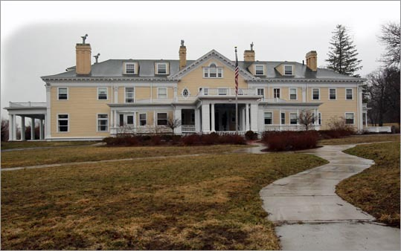
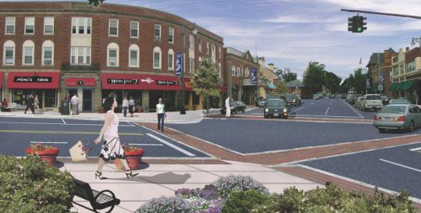
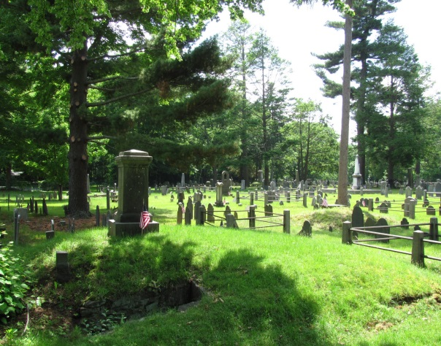
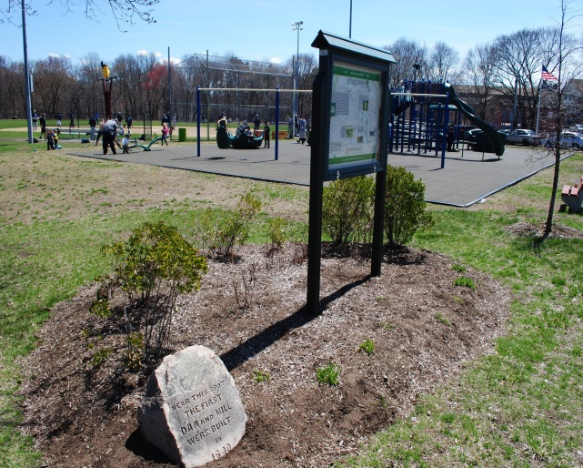
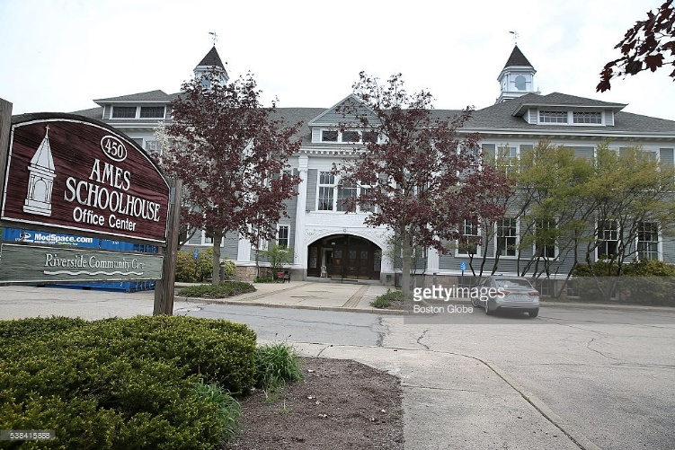
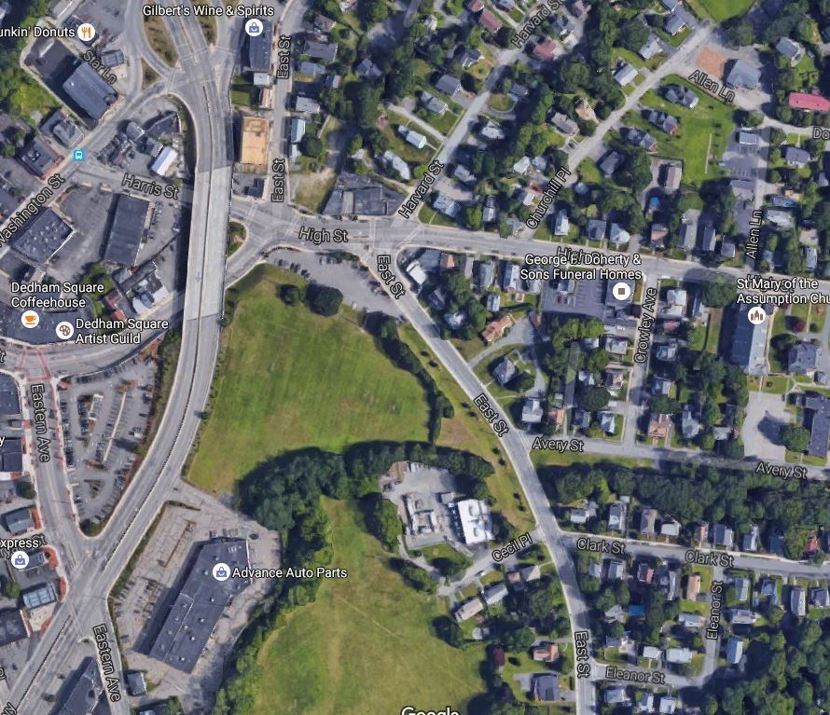
Community Preservation Act (CPA)

Slide 12
Community Preservation Act (CPA)
Since 2011, The Town of Dedham has done 24 projects that would have been CPA elligible.
The Total Cost of These Projects in between 15-20 Million Dollars.
The Taxpayers paid 100% of the cost, passing on MILLIONS of CPA Trust Fund dollars.

Slide 13
CPA What is it? How does it work? (cont.)
If the Town had approved a 1% CPA in 2003 (with 100k excluded):
The Town Would Have Raised $10.63 Million Dollars.
Of the 10.63 Million Raised, only 4.35 would have come from residential taxpayers.
The Average Annual Surcharge to Residential Taxpayers would have been $39.75 each year.

Slide 14
Gonzalez Field Project
$2.4 Million Dollar Soccer Field and Recreation Complex Approved At Town Meeting Spring 2016
Will be financed by Ten Year Bond
The Average Annual Payment from the town will be: $254,000
The cost to the average residential taxpayer will be: $20.00

Slide 15
Gonzalez Field Project
Under the current arrangement Dedham’s taxpayers will be spending about $17.00 per year from their tax bill for the next ten years to fund bonds on CPA eligible components of Gonzalez Field.
If we had used the CPA, the residential and commercial taxpayers would have paid about $10 a year and the rest would have came from CPA Trust Fund

Slide 16
Key Points
The Town is under no obligation to spend any money in any one year.
Level effort capital expenditures will result in a lower tax burden on Dedham residents.
In year 1 we will shift the cost of the surcharge from the Regular Tax levy. This will not be a tax increase.
As the town does projects in the subsequent years the savings for town will be considerable.

Slide 17
Community Preservation Act (CPA)
The town can do the same amount of projects for less money, or spend the same amount of money and do additional projects.
The final say would be up to Town Meeting.
A way to bring state tax dollars that Dedham taxpayers are paying through Registry Fees to the state back to Dedham and not to other communities.
Even at a 30% or less match will still bring millions back to Dedham. It is a GREAT and guaranteed investment.
There is NO evidence that CPA reimbursements will end and this would require act of legislature.

