Slide 1
Dedham’s Taxation Aid Fund
A new program to assist Dedham’s elderly and/or disabled residents pay their property taxes

Slide 2
Qualified recipients are elderly and/or disabled resident homeowners with limited income and assets.

Slide 3
Who is Eligible?*
Those who are:
Elderly ― 60 or older
Disabled ― Not able to work and currently receiving government disability
Titled owner of the property or hold a life estate in property
Have lived in Dedham and paid real estate taxes on primary domicle for at least 5 sequential years
Gross income limits: Single, $40,000
                Couple, $55,000
*For more complete eligibility details please see the Guidelines document. This slide only presents an outline of the requirements.

Slide 4
Applications are due by November 1 for the following fiscal year.
The full guidelines and application materials are available at:
http://www.dedham-ma.gov/taxation-aid-committee
Also, from the Offices of the Treasurer and the Assessor or from the Senior Center

Slide 5
Questions?
Need a little help with this?
For questions or help filling out the application, please call:
Council On Aging (781) 751-9650
Email: taxaid@dedham-ma.gov
For any other inquiries you may contact:
Treasurer / Collector’s Office (781) 751-9160
Assessor’s Office (781) 751-9130

Slide 6
The Taxation Aid Fund is solely supported by donations from individuals, businesses, community groups, churches, and friends.

Slide 7
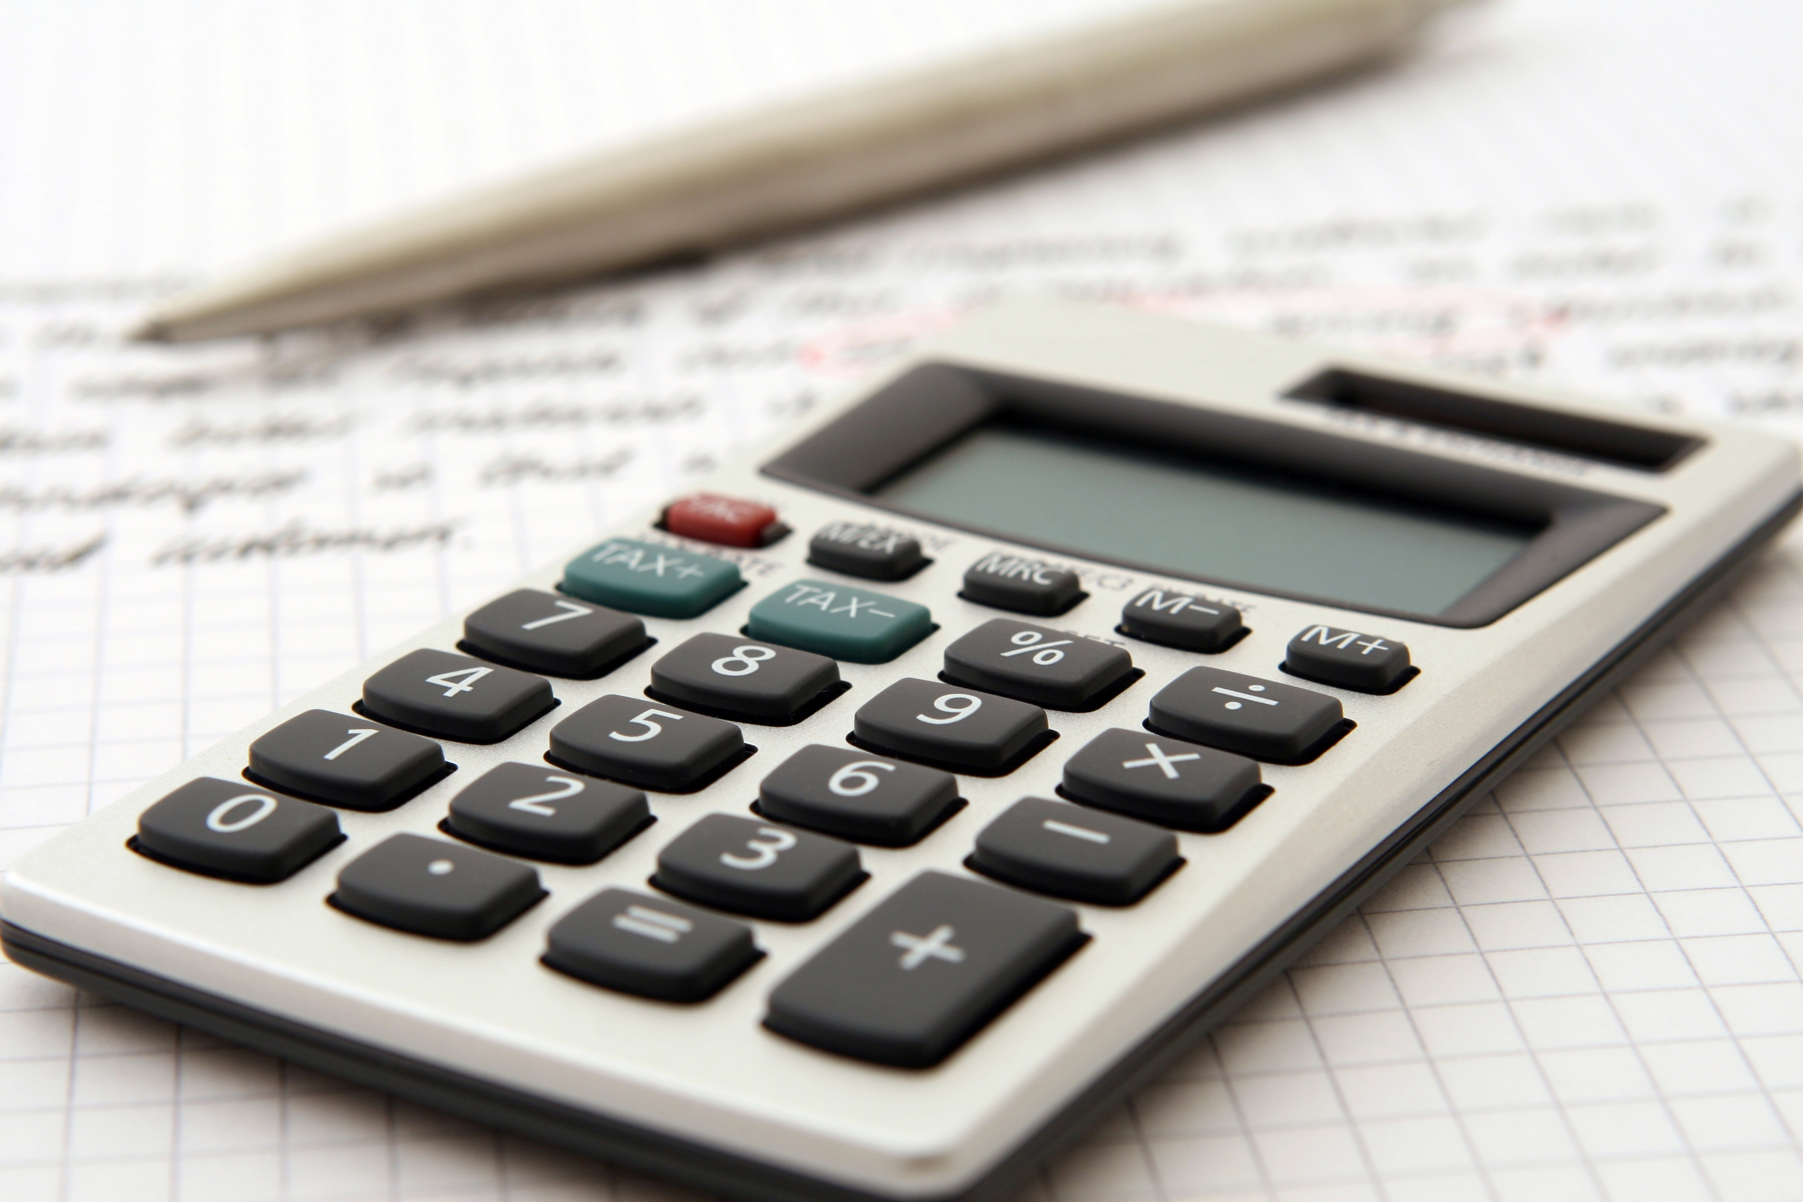
Want to donate to help fellow Dedham residents age in place?
Donate via the check box on your real estate tax bill or send a check to: Town of Dedham Treasurer’s Office
Taxation Aid Fund
450 Washington Street
Dedham, MA 02026

Slide 8
Thank you!

