Slide 1
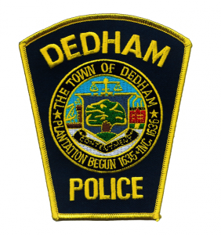
Dedham Police Department
2017 2nd Quarter Traffic Analysis
Total Accidents Reported: 231
5.71% decrease from previous quarter
15.07% decrease from 2nd quarter 2016
Providence Hwy: 64 accidents, 3.22% increase from previous quarter, 19.98% decrease from 2nd quarter 2016. Providence Highway accounted for 27.7% of all reported accidents.
High St: 19 accidents, 20.83% decrease from previous quarter, 34.84% decrease from 2nd quarter 2016,
High St. accounted for 8.22% of all reported accidents
Washington St: 23 accidents, 4.54% increase from previous quarter, 14.81% decrease from 2nd quarter 2016, Washington Street accounted for 9.95% of all reported accidents.

Slide 2
Accidents with Injury: 34 Accounts for 14.71% of all accidents No change from previous quarter 10.52% decrease from 2nd quarter 2016
Providence Highway: 7, accounts for 20.58% of accidents with injury, 36.36% decrease from previous quarter, 30% decrease from 2nd quarter 2016.
High Street: 2, accounts for 5.88% of accidents with injury, 66.66% decrease from previous quarter, 66.66% decrease from 2nd quarter 2016
Washington Street: 8, accounts for 23.52% of accidents with injury, 300% increase from previous quarter, 60% increase from 2nd quarter 2016.
Washington St. saw a significant increase in accidents with injury. 50% of these accidents occurred in the intersection of Washington St. @ Elm St.
Pedestrian Accidents: 11
Accounts for 4.76% of all accidents
175% increase from previous quarter
83.33% increase from second quarter 2016
27% of pedestrian accidents occurred in parking lots

Slide 3
Traffic Complaints Received: 22
15.78% increase from previous quarter
46.66% increase from 2nd quarter 2016
Location and Type of Complaint
Bussey St. and Milton St.- Complaints of excessive motorcycle noise
235 Common Street- Speeding Vehicles
Holmes Road- Speeding Vehicles
Richards Street- Residents concerned with street being used as a cut through/speed
Chestnut Street- Speed and Stop sign violations
Oakland Street- Vehicles passing stopped school bus/speed
Washington @ Spruce- Crosswalk and Speed violations
The majority of traffic complaints this quarter were regarding construction and other work in the area.

Slide 4
Citation Data
April 2017: 650
May 2017: 688
June 2017: 464
Speeding Violations: 911
Red Light/Stop Sign Violations: 252
14.01% of all citations were issued on Providence Highway
14.46% of all citations were issued on High Street
7.61% of all citations were issued on Washington Street

