Slide 1
Facilities & Maintenance SUMMER 2016 SCHOOL CAPITAL PROJECTS PREVIEW
Prepared By: Denise Moroney,
Director of Facilities
April 27, 2016

Slide 2
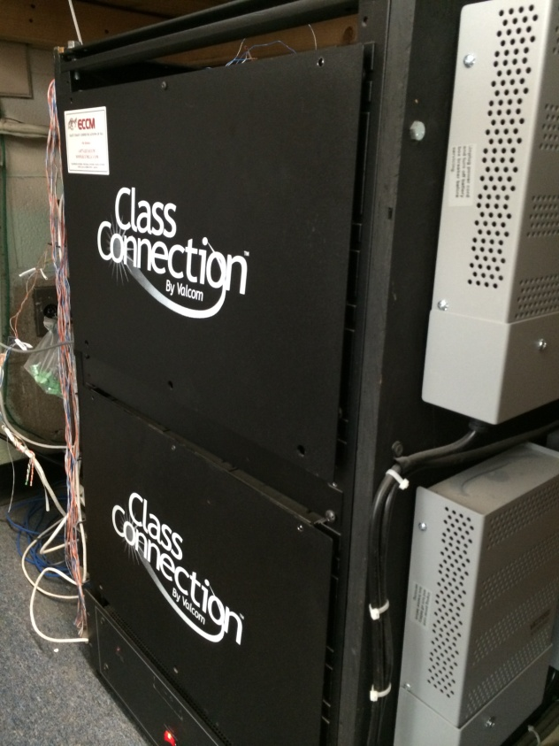
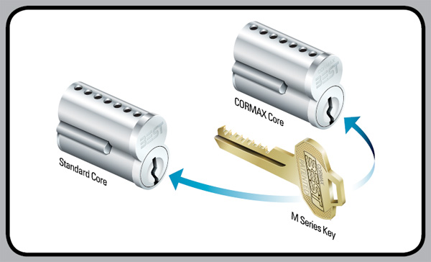
Summer 2016: School Security
*DHS PA System
-New Telecor system to be installed over April 2016 vacation
-Rewiring and new speakers – to be bid in June with July/August work performed
KEYSCAN SWIPECARD ACCESS & AURORA SOFTWARE INTEGRATION
DHS PA SYSTEM
NEW LOCKSETS – IMPROVED SECURITY

Slide 3
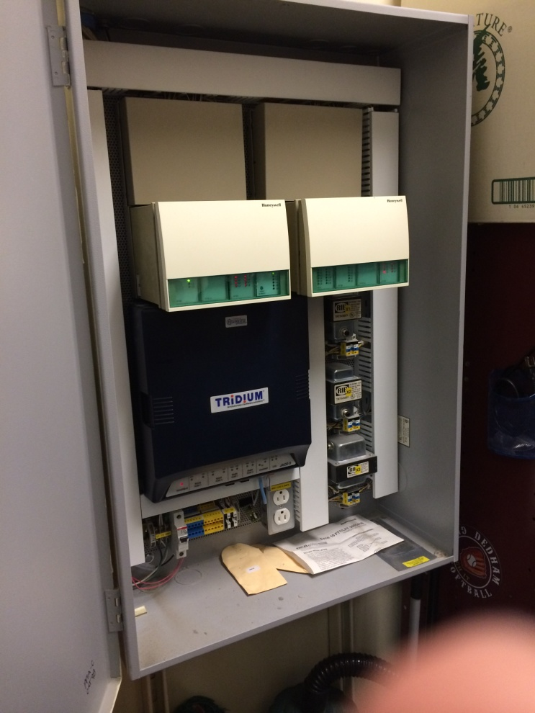
Summer 2016: Middle School EMS Controls
ALERTON ENVISION FOR BACTALK at AVERY SCHOOL
DMS - CURRENT TRIDUUM
EMS CONTROLS – 10+ YEARS OLD
SIEMENS - ALL OTHER TOWN & SCHOOL BUILDINGS

Slide 4
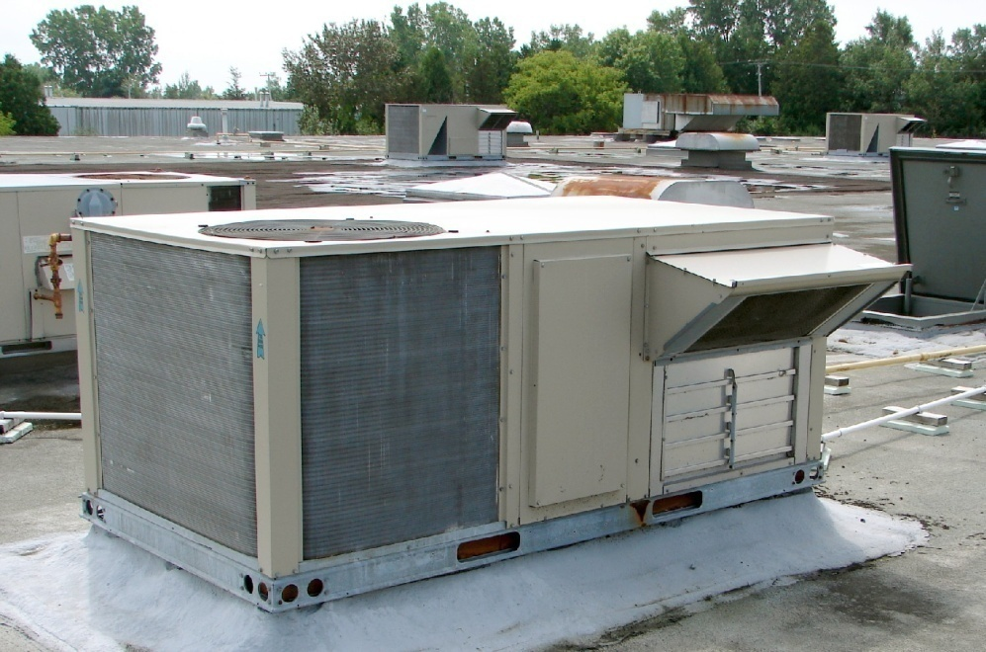
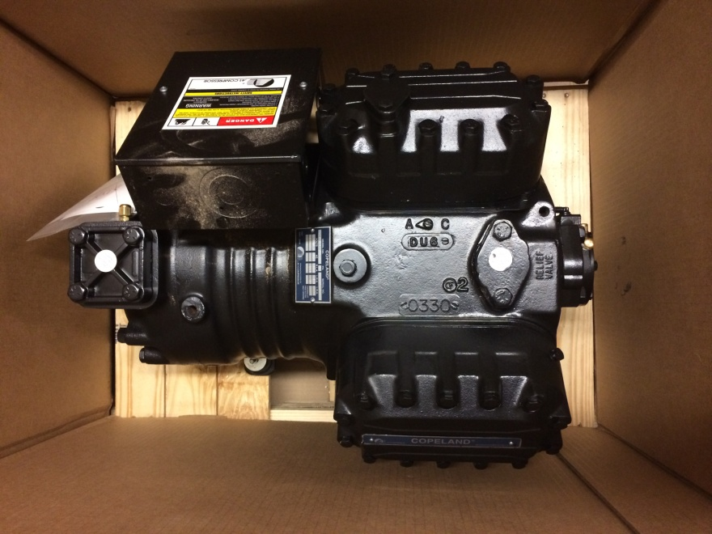
Summer 2016: HVAC Replacements
Compressors: RTU3 serving D&E wing interior classrooms in High School (no windows) and RTU5 serving Kitchen/Cafeteria
TYPICAL HVAC ROOFTOP UNIT
COMPRESSOR

Slide 5
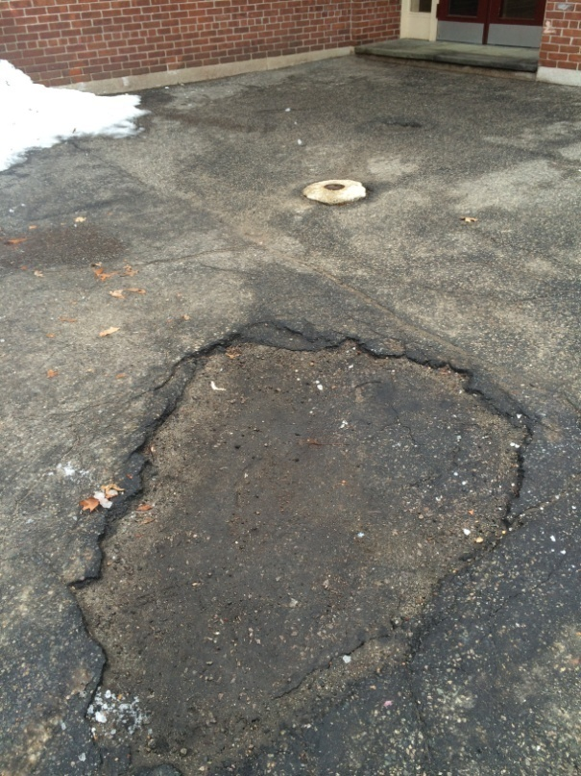
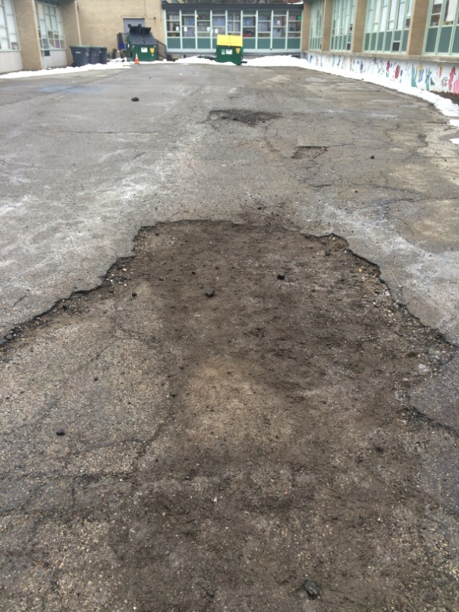
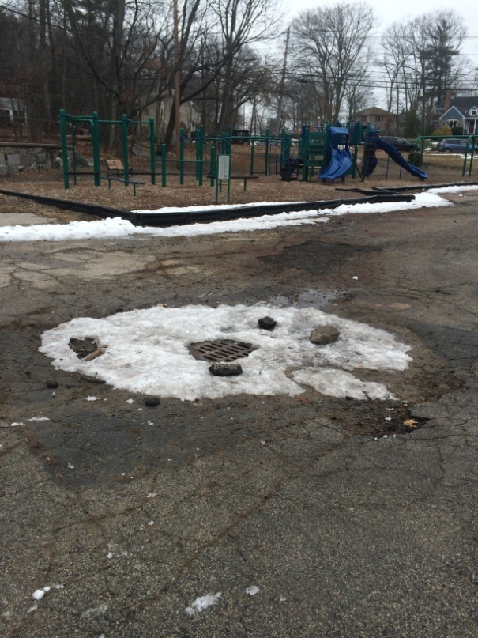
Summer 2016: Asphalt Resurfacing
*Oakdale & Greenlodge Paving Construction per DPW schedule – coordinate with Joe Flanagan
OAKDALE REAR COURTYARD
GREENLODGE COURTYARD & PLAYGROUND AREA

Slide 6
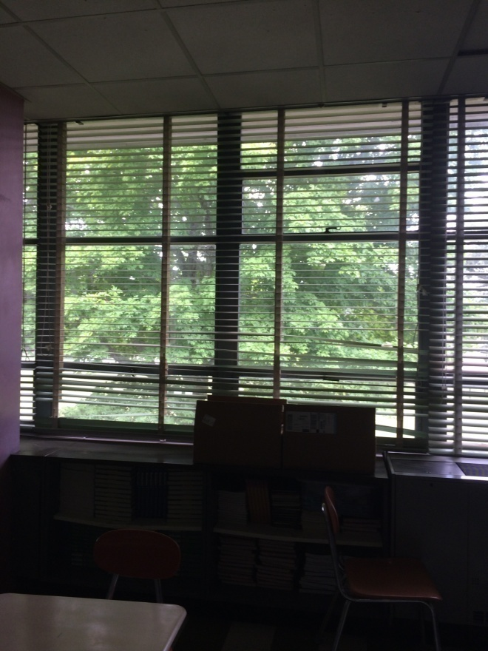
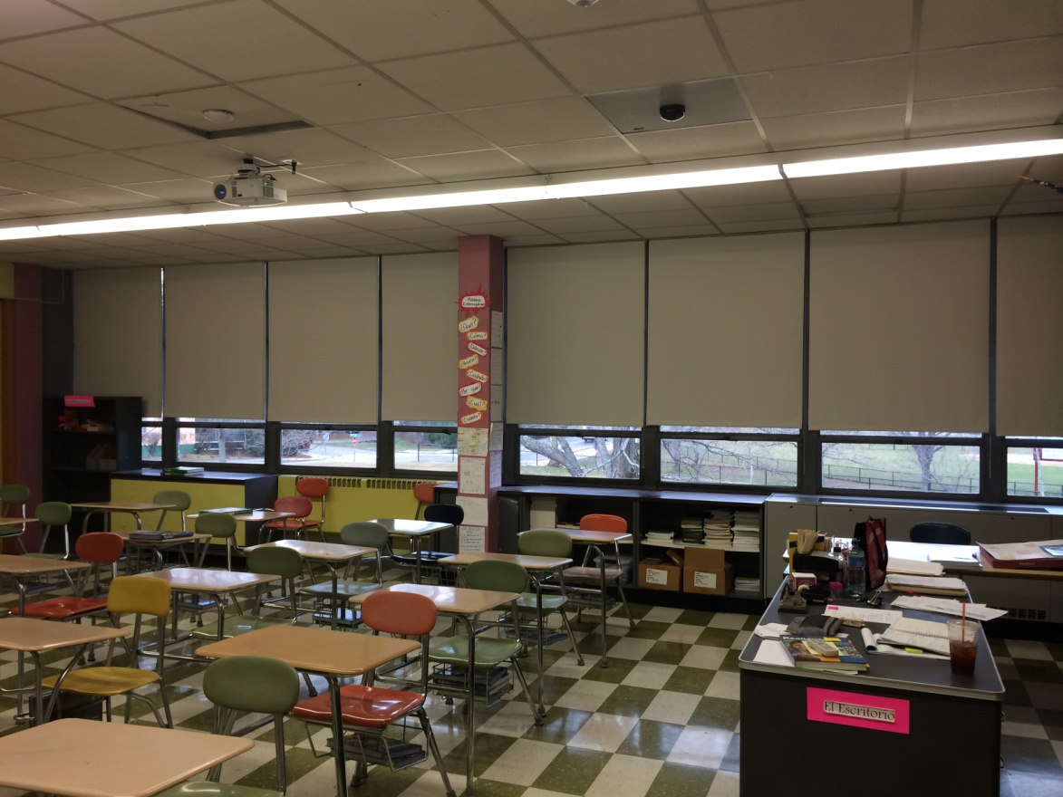
Summer 2016: Shade Replacements
430 DHS WINDOWS – INSTALL LIGHT BLOCKING SHADES:
DIFFICULT FOR STUDENTS TO LEARN WHEN WHAT IS PROJECTED CAN’T BE SEEN

Slide 7
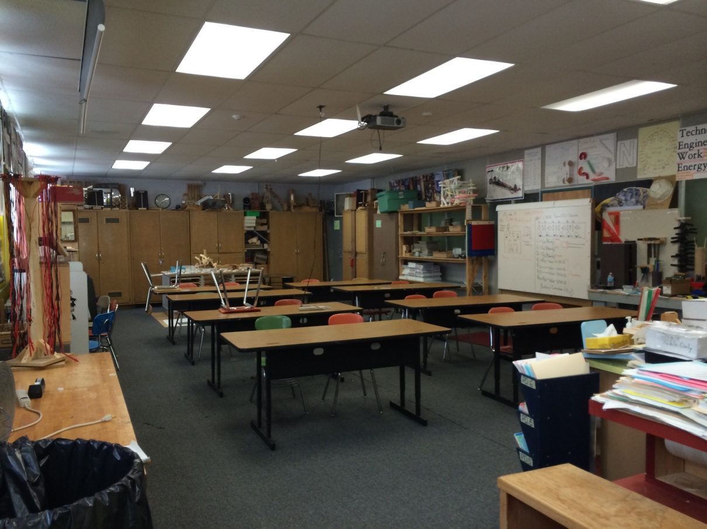
Summer 2016: Engineering Lab/Art Classroom
REQUEST FOR ART TEACHER IN OPERATING BUDGET – NEED A 3RD ART CLASSROOM
MOVE ENGINEERING LAB TO E201/202; ENGINEERING LAB BECOMES ART ROOM
REPLACE CARPET WITH FLOOR TILE & NEW HVAC SYSTEMS FOR ALL ART ROOMS

Slide 8
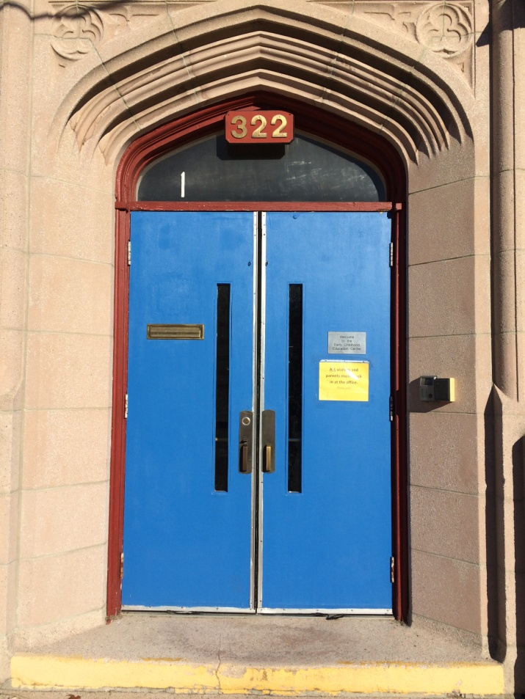
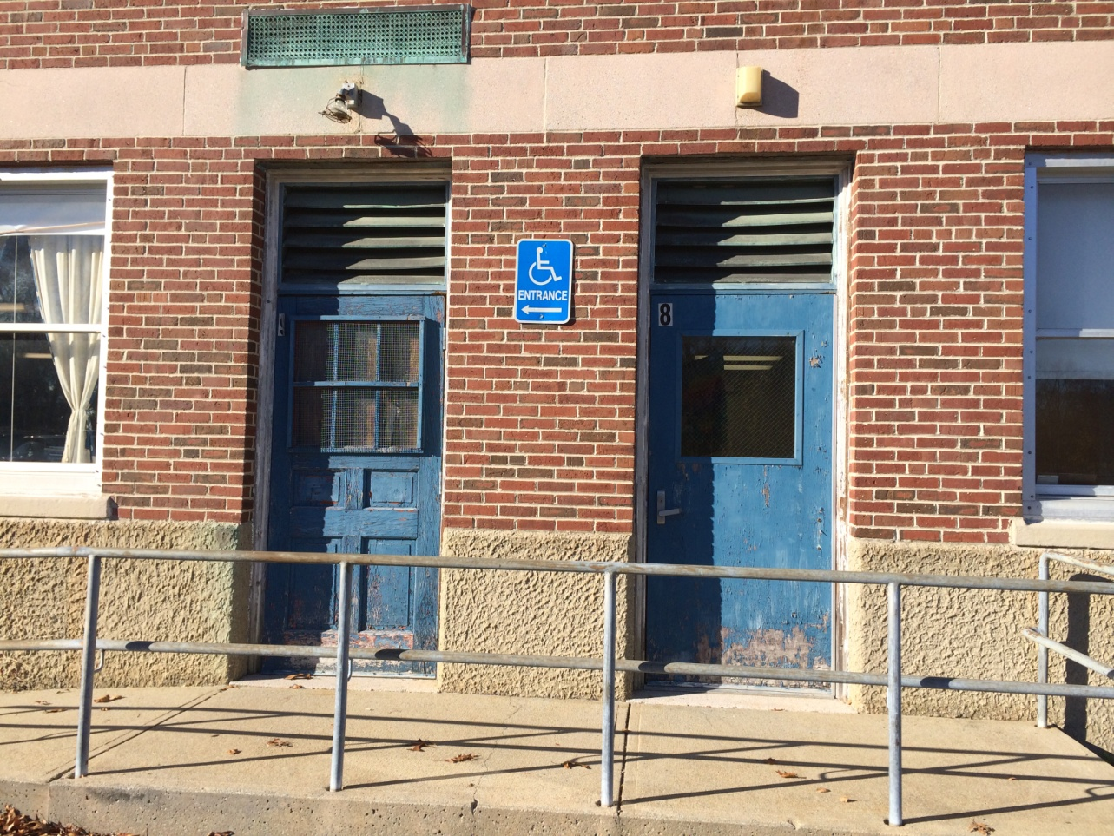
Summer 2016: Exterior Doors
ECEC MAIN ENTRY

Slide 9
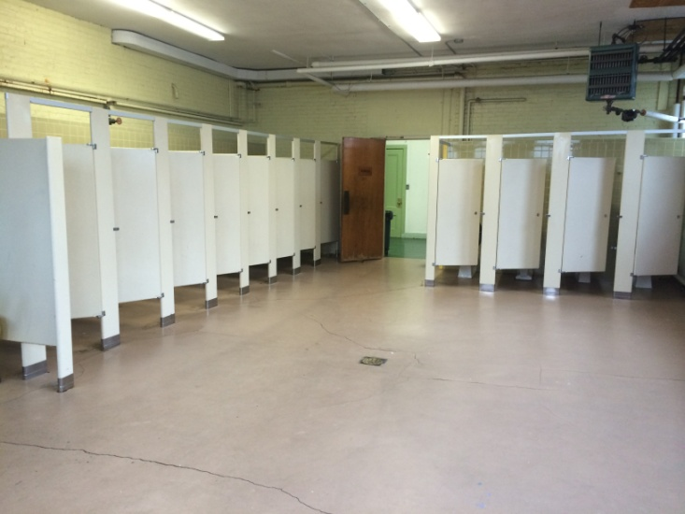
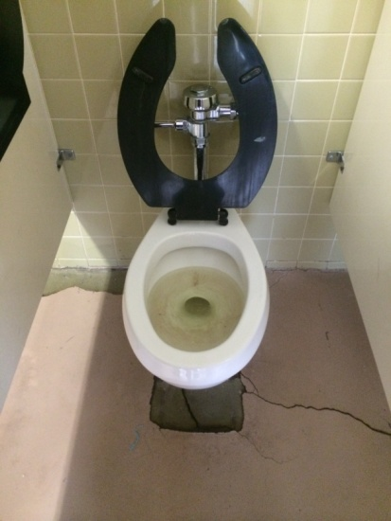
Summer 2016: Bathroom Renovations
*Oakdale Girls Bathroom – new toilets, sinks, flooring and partitions
CURRENT OAKDALE GIRLS BATHROOM – FLOOR/PARTITIONS/TOILETS TO REPLACE

Slide 10
Spring/Summer 2016: Other Projects
*DHS Youth Commission office renovations
-construct three private offices in July 2016 with combo effort in house and external vendors
*DHS Nurse Suite kitchen
-August construction with combo effort in house and external vendors
*DHS Whiteboard replacement
-April to May 2016 develop scope of work for bid for remaining 60+/- classrooms
potential for 19 Special Education classrooms in June
pending capital funding for 18 classrooms for July/August construction
*DHS Transformer replacement
-NSTAR to replace poles starting May 2nd from DHS to DMS
-Cabling from Transformer to Switchgear to be bid in May/June
-Cutover to new transformers in late July/early August
*DHS Lower Gym Entrance
– accessibility design in process
Construction per DPW schedule – coordinate with Joe Flanagan
*DHS & Greenlodge Ceilings
– DHS Main Office to Supt. Office – to be bid in May/June – install w/new lighting - July & August 2016
Greenlodge rear wing hallway to receive new ceilings & LED lighting – July & August 2016
*Interior Painting
– hired temporary painter work done at DMS, ECEC – next is Oakdale
-Greenlodge rear wing hallway painted over April vacation

Slide 11
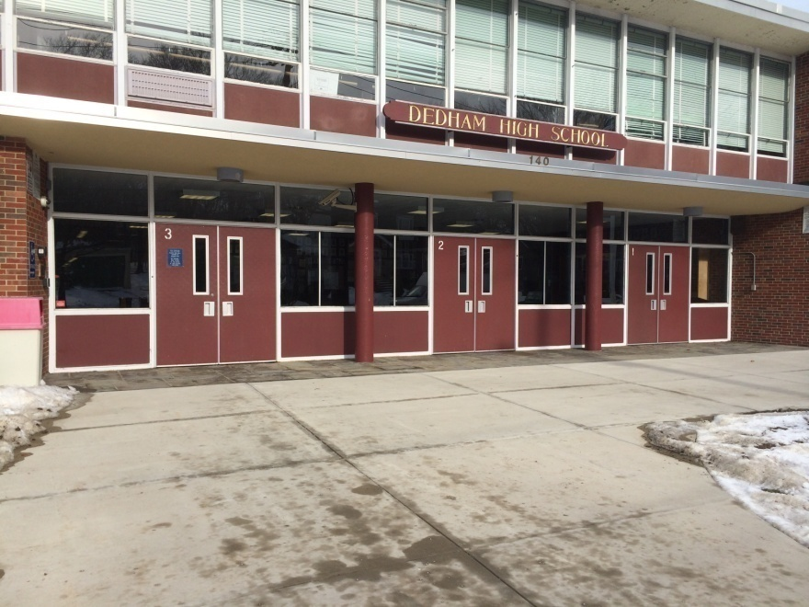
FUTURE LOOK to Summer 2017: DHS Lobby Security
CURRENT DHS MAIN ENTRY
PROPOSED DHS SECURITY VESTIBULE – SUMMER 2017

