Slide 1

Dedham Facilities Department –
School Committee
Summer 2016 Project Review
Presented by: Denise Moroney, Director of Facilities, 10/5/16

Slide 2

Summer 2016: 10 DHS Projects
1. Telecor PA System
2. Power Transformer/Switchgear
3. CAD Lab/Engineering Lab & Art Studio#3
4. Kiln Relocation
5. Lower Gym Entrance
6. Whiteboard Installation
7. Room Darkening Shades
8. Ceilings in 1st Floor A wing & B wing
9. Nurse Suite Kitchenette
10. Youth Commission Offices

Slide 3
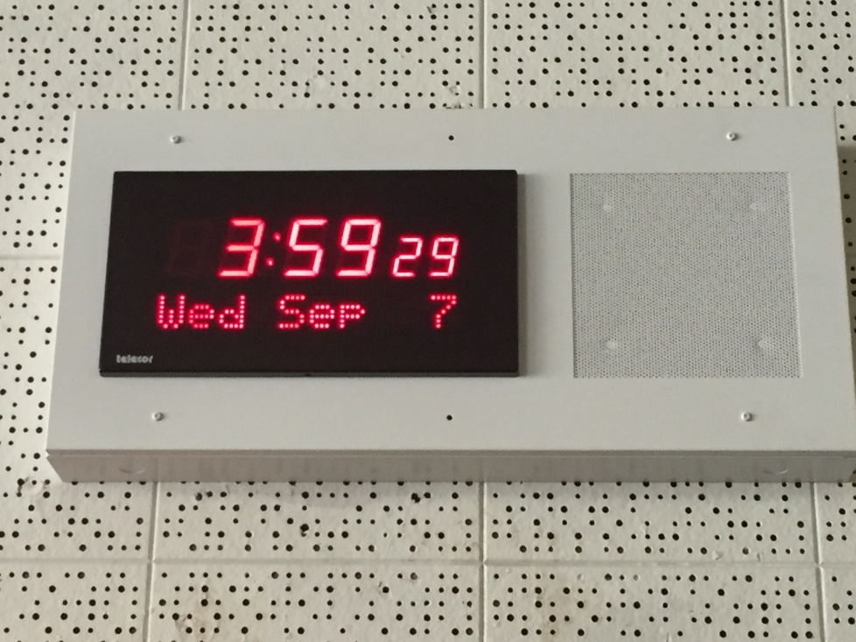
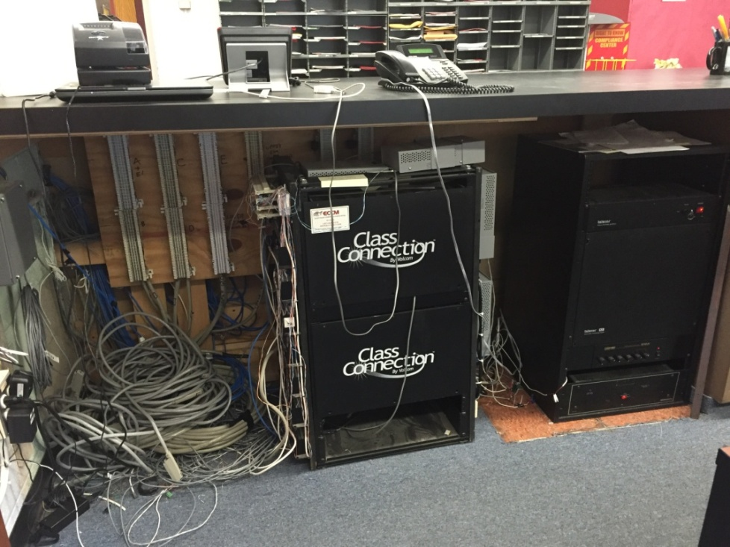
DHS Telecor PA System
*DHS has been in dire need of a new PA system for several years – no sound/scratchy incoherent messages
*Replaced Class Connection system with Telecor in April 2016
*Rewired entire DHS speaker system
*Installed 125 new digital clock/speaker combo units
*Now able to hear all PA messages clearly
*Added benefit of digital time, date, and digital messaging (Lockdown)

Slide 4
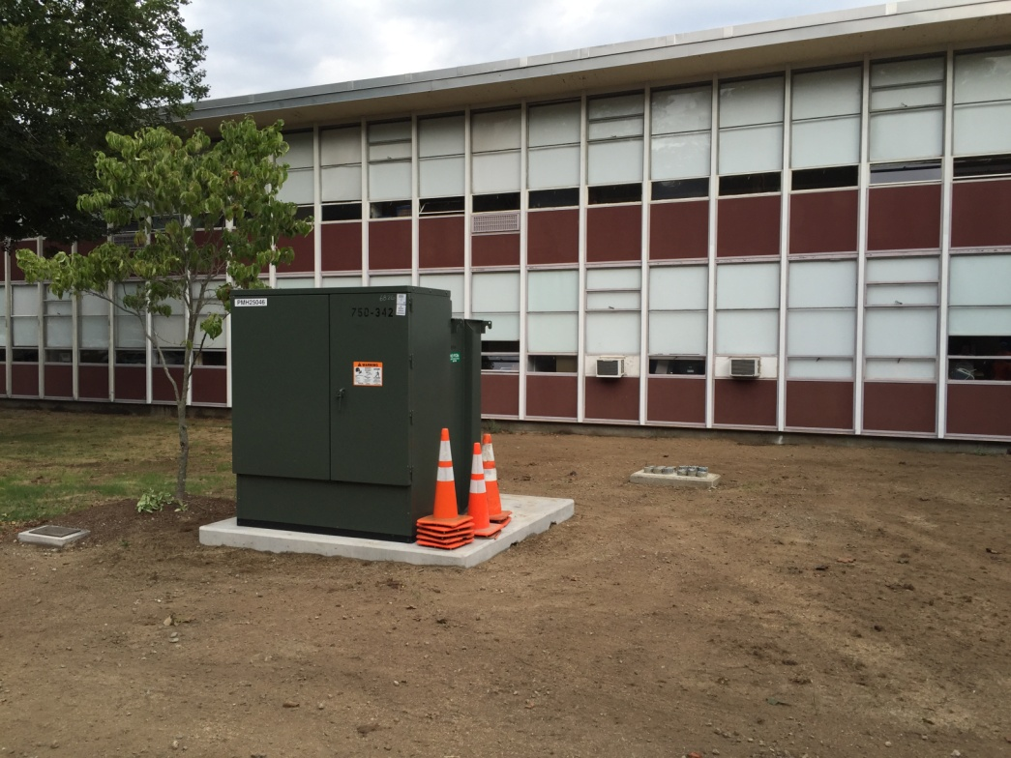
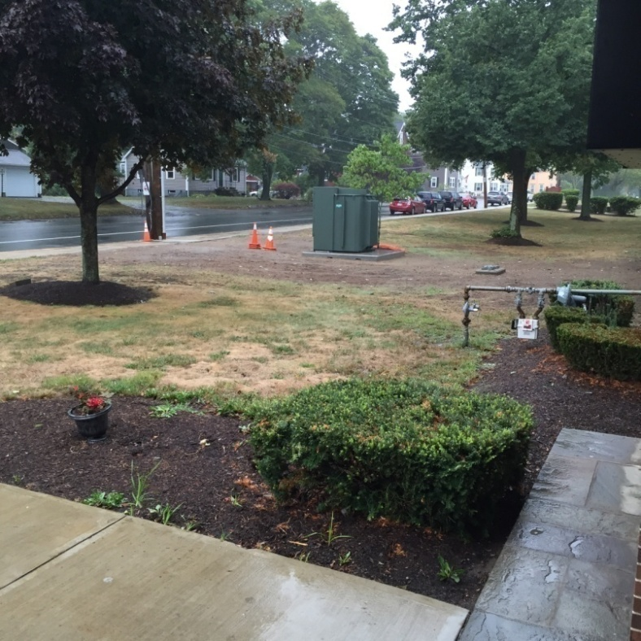
DHS Transformer Project
*PCB Transformers to be removed from vault room in DHS basement
*Installed cabling for new transformer in front of the building
*Improves reliability and response time as fed from same service as Legacy Place
instead of residential loads
*Switchgear to be installed in existing transformer vault room in DHS basement
*Power cutover to new transformers to be scheduled for December 2016 break

Slide 5
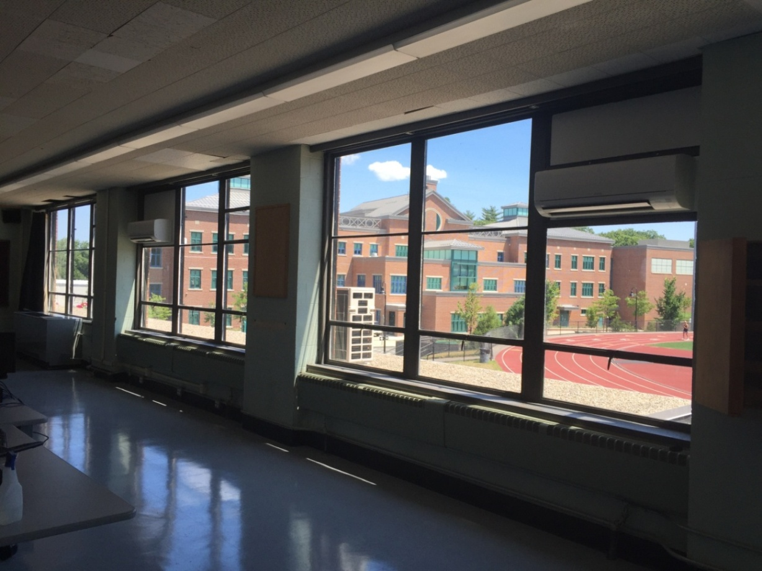
DHS Cad Lab
*Removed asbestos floor tile, installed new VCT flooring, new whiteboards and
room darkening shades – all to improve learning
*Air Conditioning: Installed ductless split to cool occupants along with 20+ computers

Slide 6
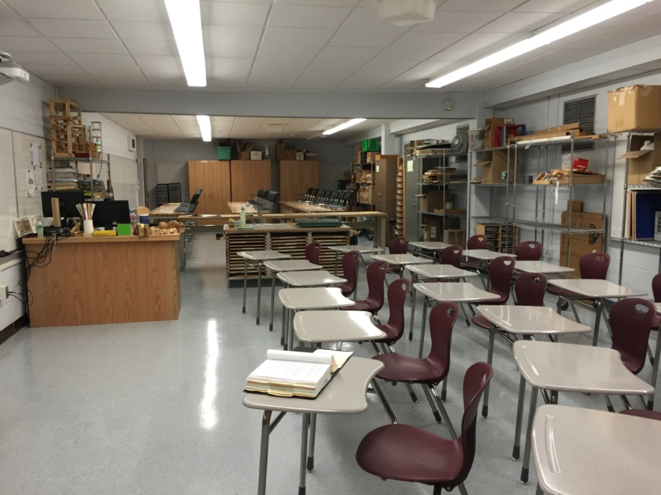
New DHS Engineering Lab
*Expanded Engineering Lab from a 1,043 sq.ft. classroom to 1,592 sq.ft.
*Rooms E201/E202: Removed internal office walls and room divider, removed
asbestos floor tile, installed new VCT flooring, painted ceiling grid and installed new
ceiling tiles plus new whiteboards and power to lab tables.
*Purchased storage cabinets, chrome wire shelving, butcher block top lab tables and
teachers desk, new Zuma student desks.

Slide 7
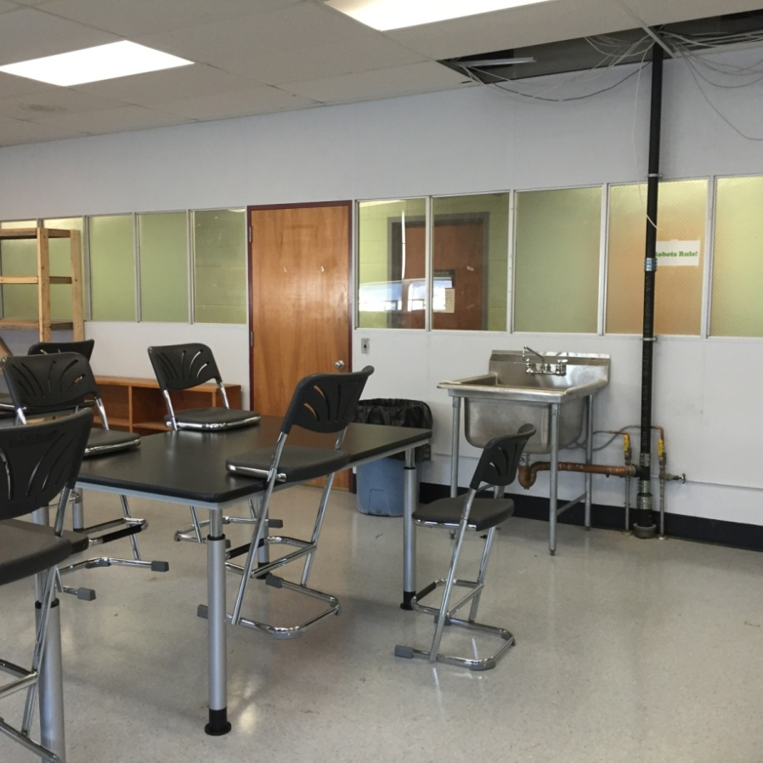
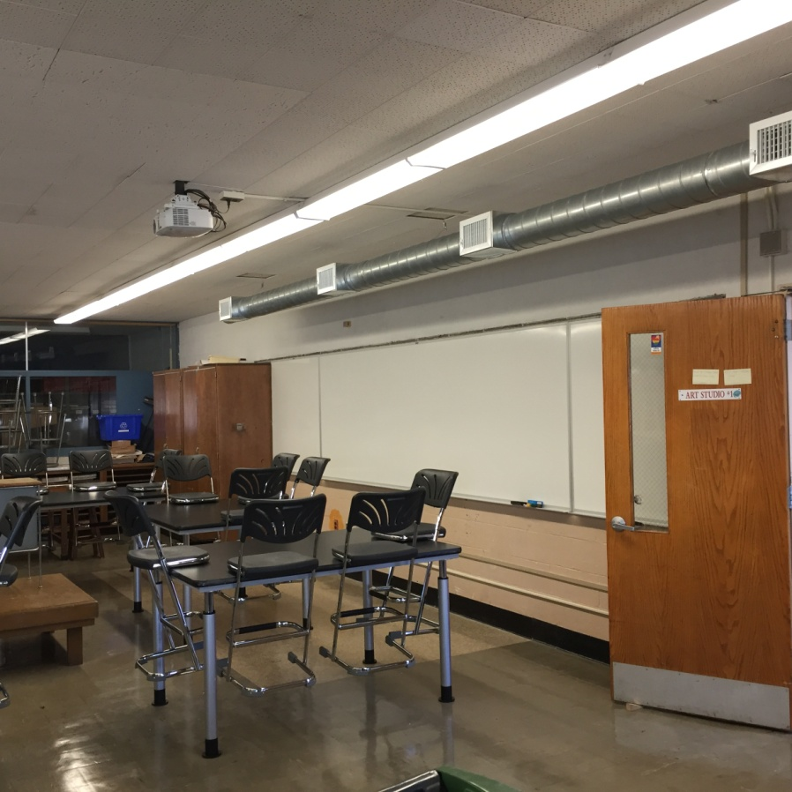
New DHS Art Studio #3
*New Art Studio #3: Removed asbestos floor tile, installed new VCT flooring,
painted walls, added a new sink and new adaptable height tables & “Z” stools
*Air Conditioning: added spiral duct system to cool Art Studio #1 and #2 and
replaced Art Studio #3 window unit
NEW ART STUDIO #3
ART STUDIO #1

Slide 8
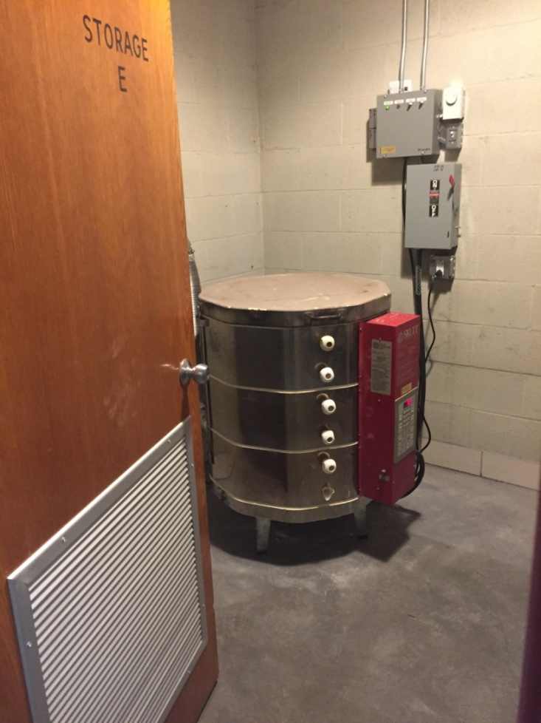
Kiln Relocation
*Moved from Band Room storage to hallway outside Art Rooms (prior Alumni storage)
*Installed new power disconnect and door grill plus ceiling/roof exhaust fans to vent

Slide 9
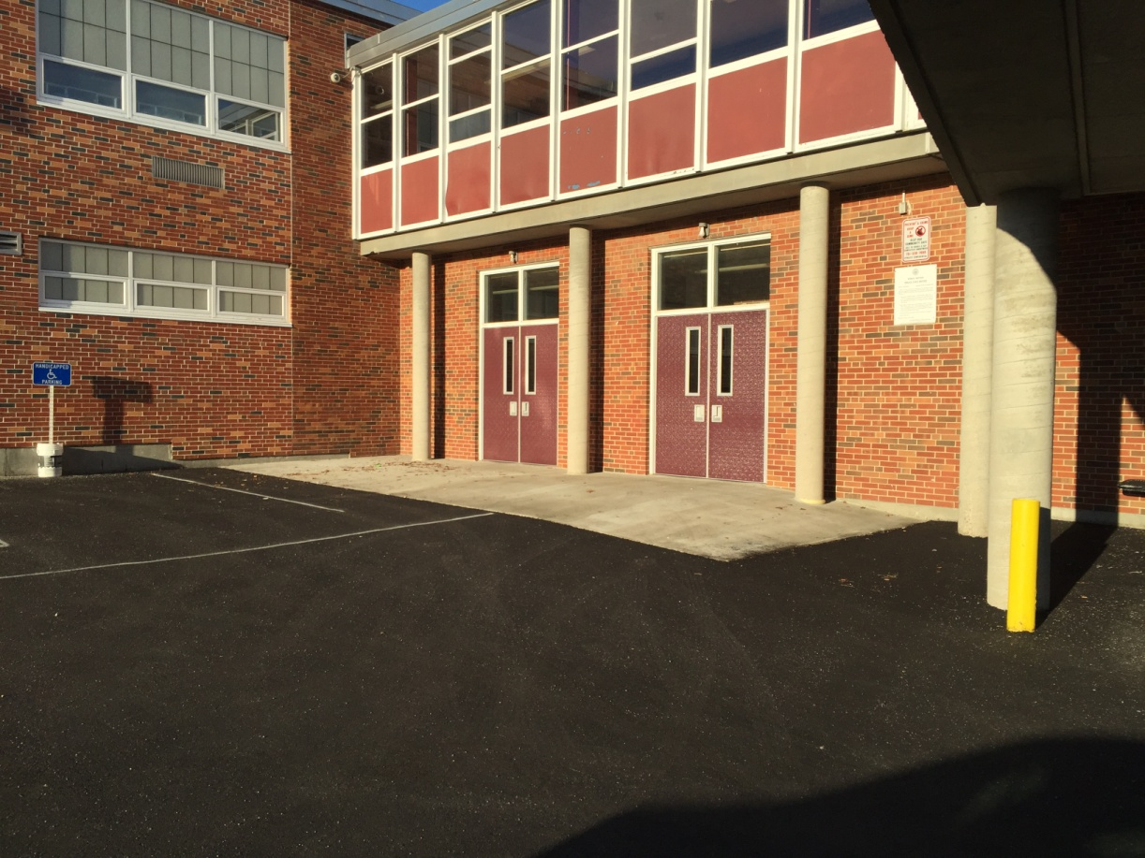
Lower Gym Entrance
*New accessible entrance at Lower Gym entrance to improve access for students, staff and visitors
*Poured a concrete landing and raised the pavement to meet new landing

Slide 10
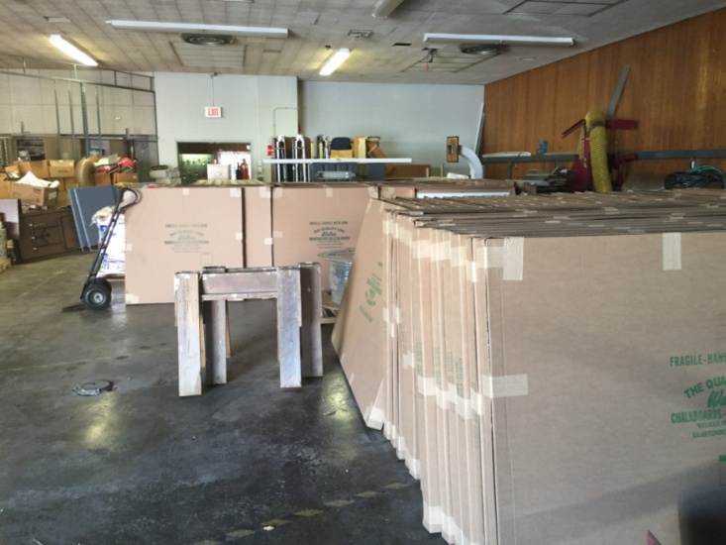
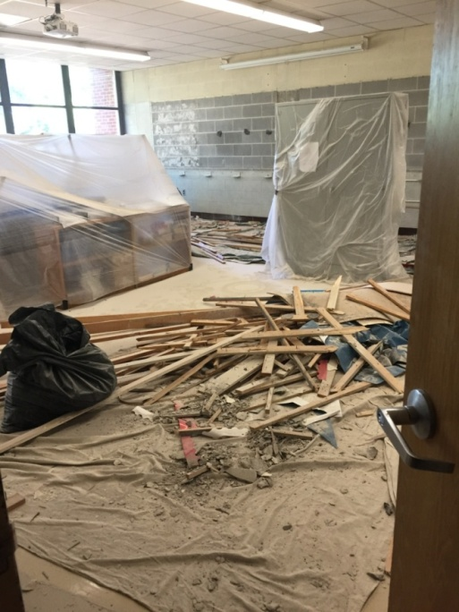
DHS Whiteboards
*Installed 293 new white boards in 37 classrooms
*Installed wall outlets for 35 interactive projectors at DHS plus 15 at Elementary Schools
*Improve quality of learning for students

Slide 11
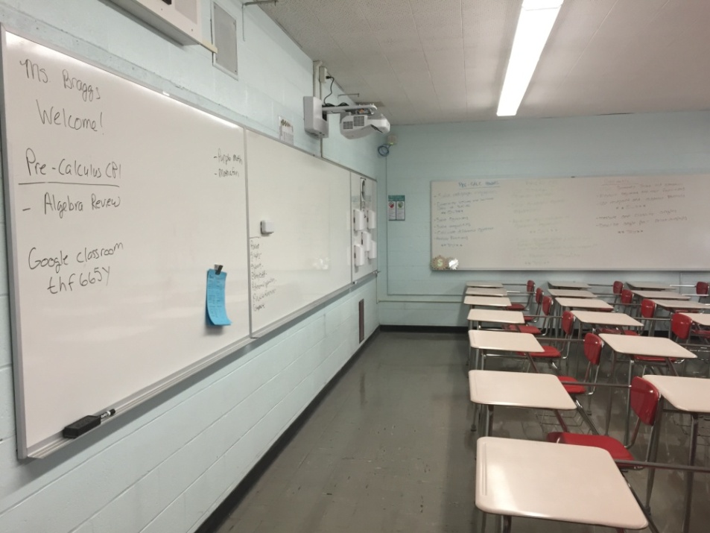
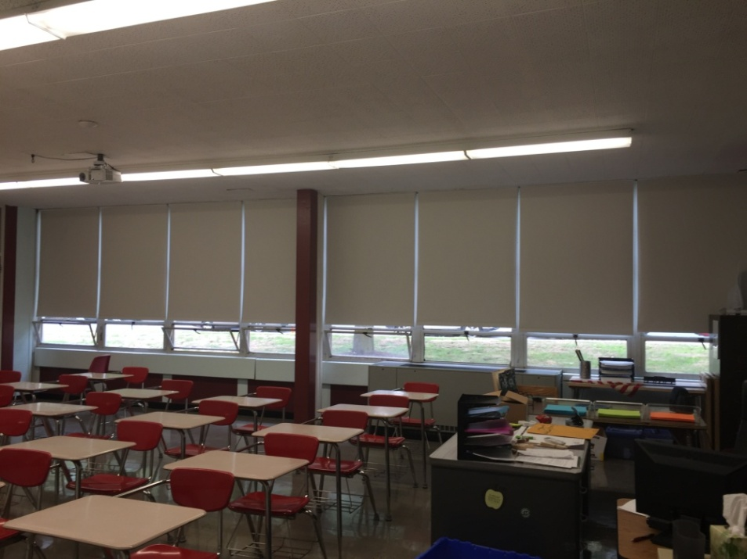
DHS Shades
* Installed 425 new room darkening shades in all classrooms
* Improved learning with no daylight to properly use projectors on whiteboards

Slide 12
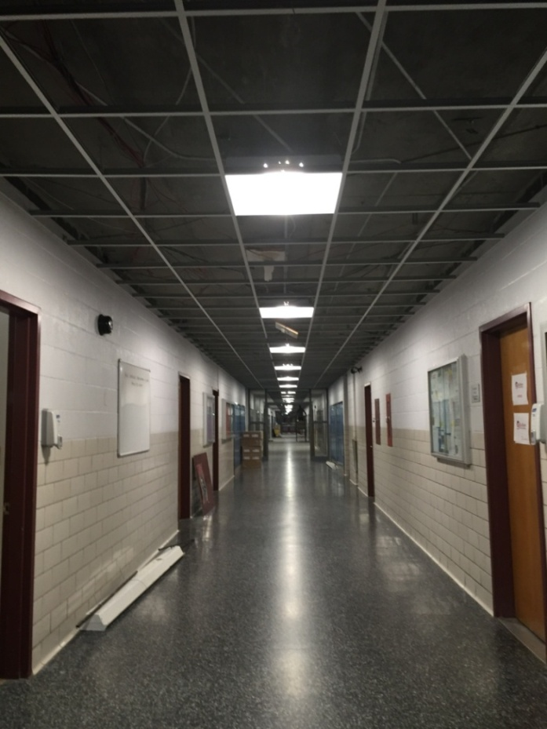
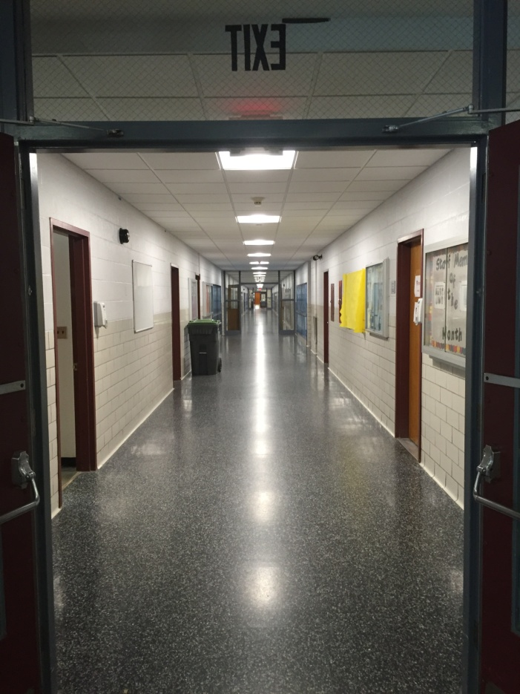
DHS Ceilings
*Installed new 2x2 ceiling tiles and LED lighting in A and B wing
* Greatly improves the aesthetics and LED lighting saves energy

Slide 13
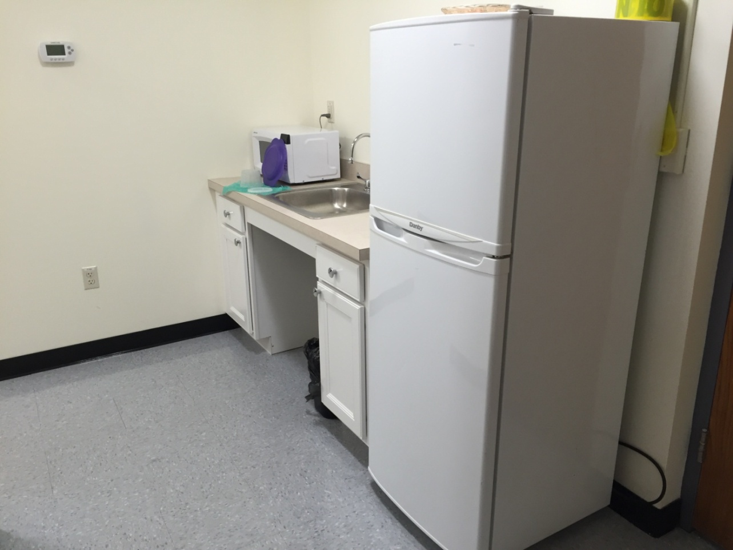
Nurse Suite Kitchenette
*Final piece to complete the Nurse suite – added a sink and countertop/cabinet base

Slide 14
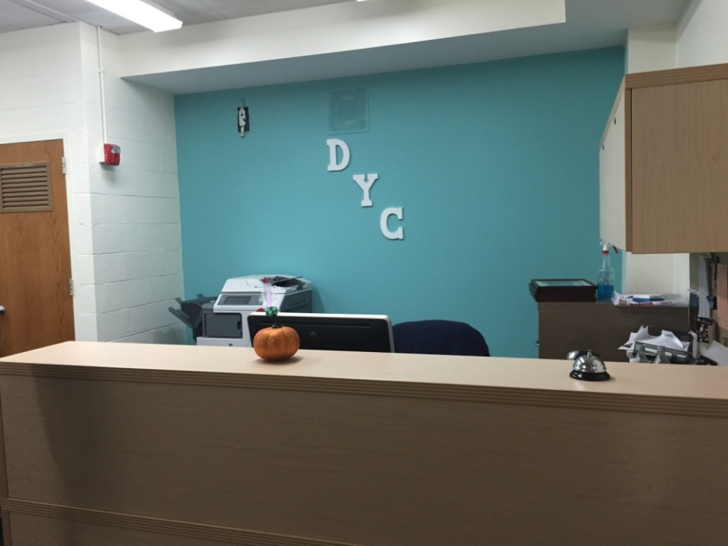
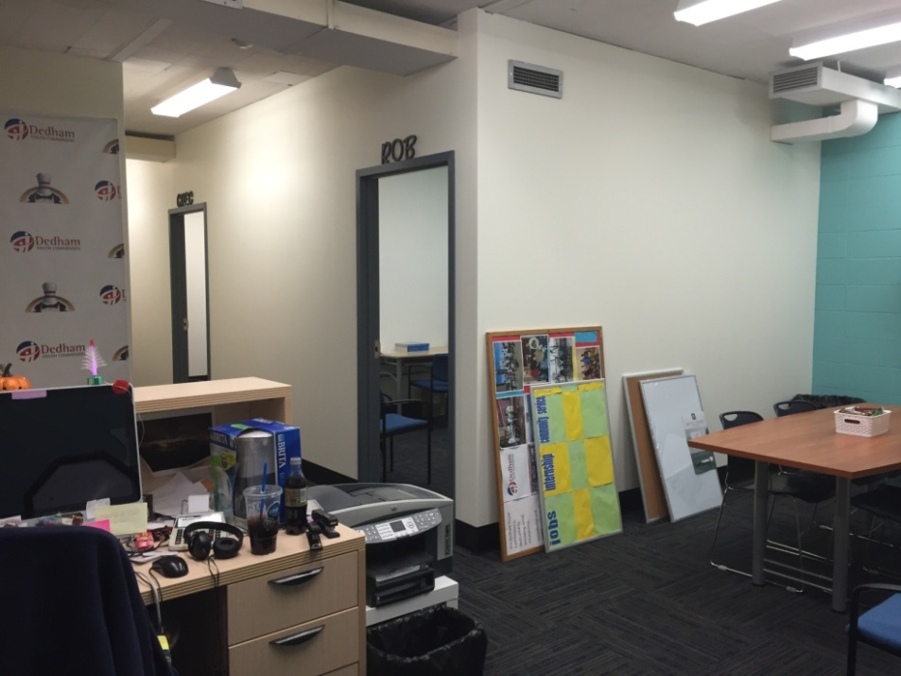
Youth Commission Offices
* Demolished half glass wall partitions & built private offices with new sheetrock walls
insulated for privacy with new data/electrical
* Painted accent walls in each office and common space with new teal blue color

Slide 15
Summer 2016:School Buildings
1. DMS HVAC EMS Controls Replacement – in process
2. DMS Window W106 removal & reinstall
3. DMS Side Door Swipe Card Access – in process
4. Greenlodge Resurfacing (Oakdale moved to 2017 - patching for 2016)
5. Greenlodge Rear Wing & Lobby ceilings & LED lights
6. Greenlodge Special Education “STAR” Playground – in process
7. Exterior Doors – 5@ Greenlodge, 3@ Oakdale, 2@ ECEC – in process
8. Oakdale Girls Bathroom Renovations
9. Riverdale Faculty Lounge - Bookcase removal/wall repair/SMARTBoard
10. Riverdale Main Office conference room

Slide 16
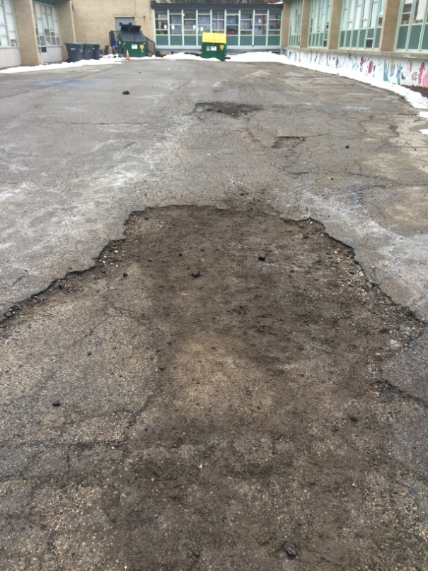
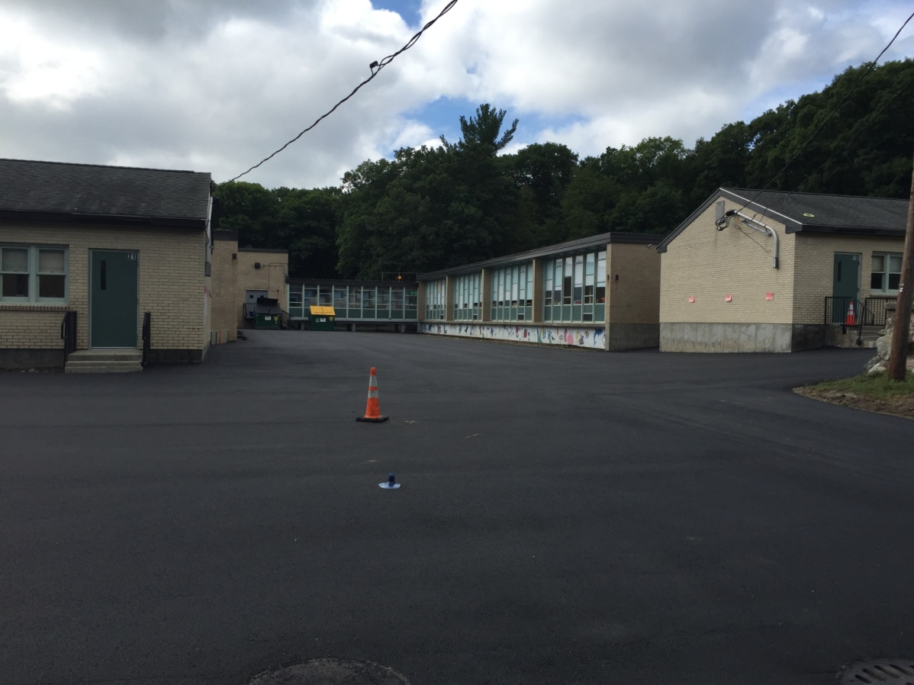
Greenlodge Resurfacing
*Bid paving for Greenlodge with alternates for Oakdale and Riverdale to be
requested for Summer 2017
*All tripping hazards removed and new areas for landscaping added throughout to
improve building exterior safety and appearance

Slide 17
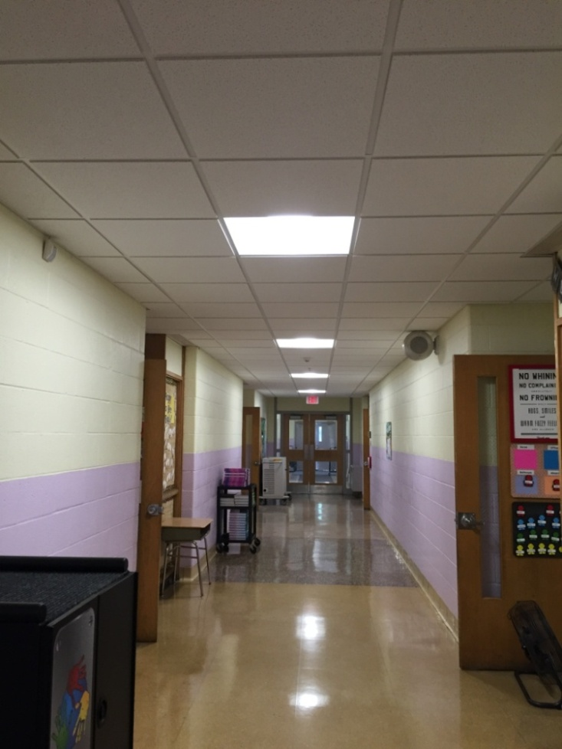
Greenlodge Ceilings
* Installed new 2x2 ceiling tiles and LED fixtures to improve the building
* Discovered emergency exit lights tied to wall switch - corrected

Slide 18
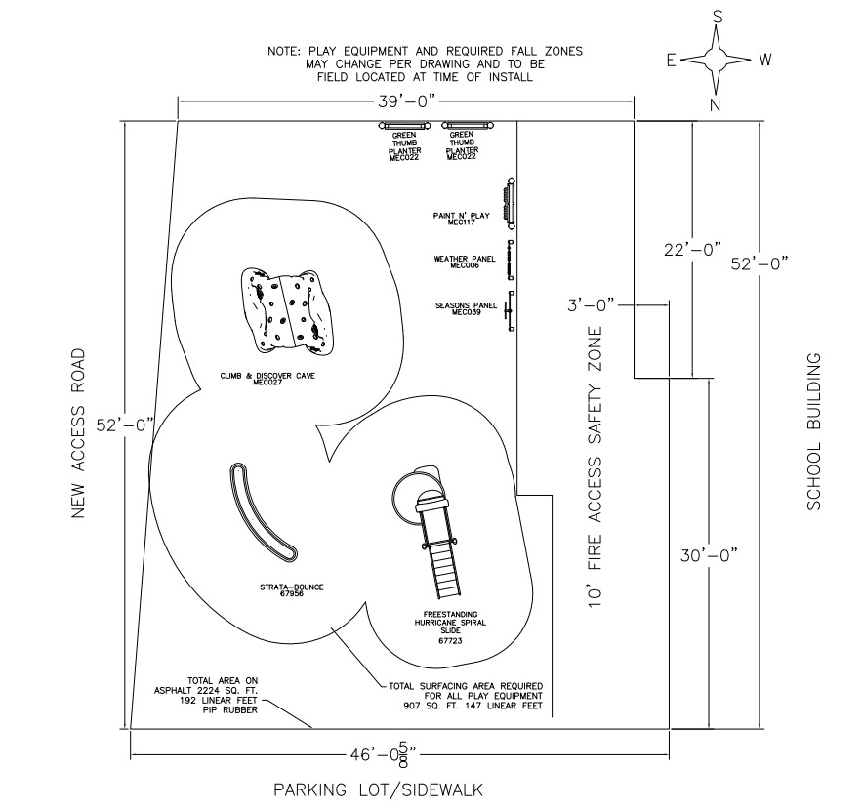
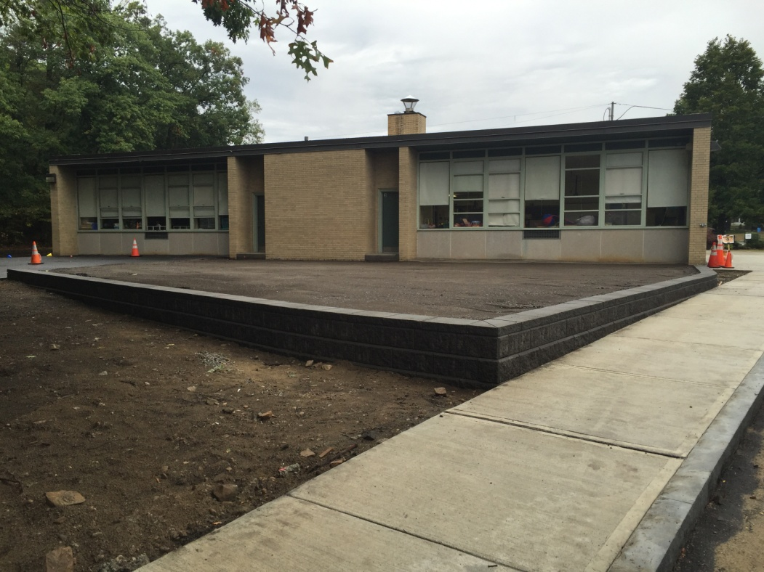
Greenlodge STAR Playground
* Surface graded and versa block wall installed
* Play structures and fencing installation in process

Slide 19
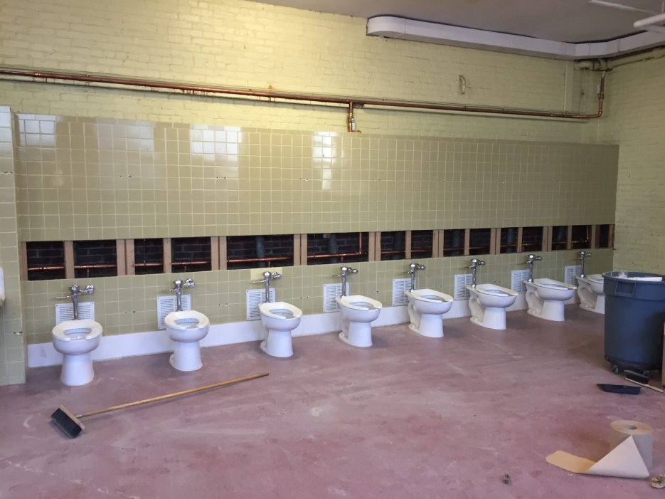
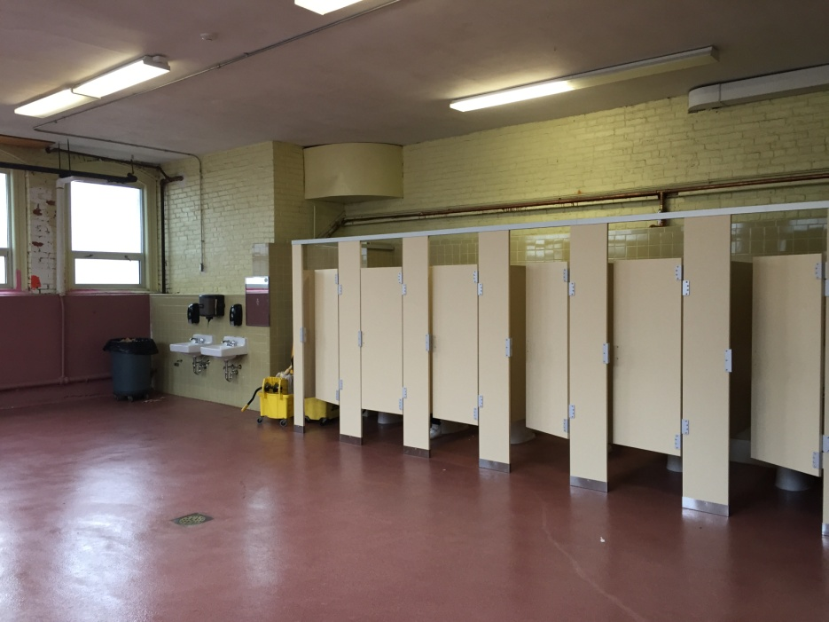
Oakdale Girls Bathroom
*Replaced eight toilets and flushometers – DWWD to provide rebate
*New supply lines as plumbing was in bad shape
*New sinks with working faucets
*New epoxy floor and solid plastic partitions

Slide 20
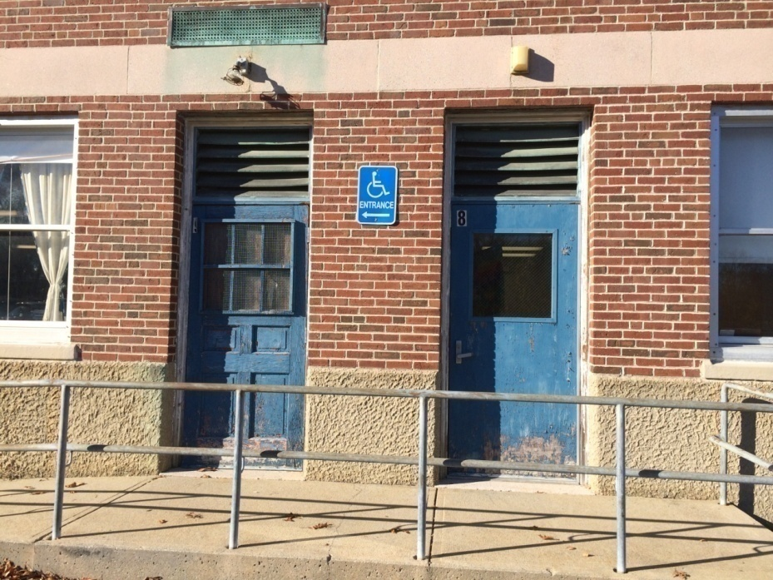
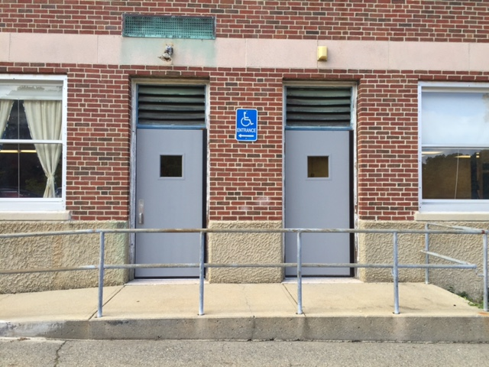
Exterior Doors
*Improve functionality, security and energy savings
*ECEC: replaced doors 8 & 9
*Oakdale: replaced doors 11, 17 & 18
*Greenlodge: Main entry doors to be replaced plus doors 2, 7 & 10 –
new hardware on doors 12 & 22 for swipe card entry

Slide 21
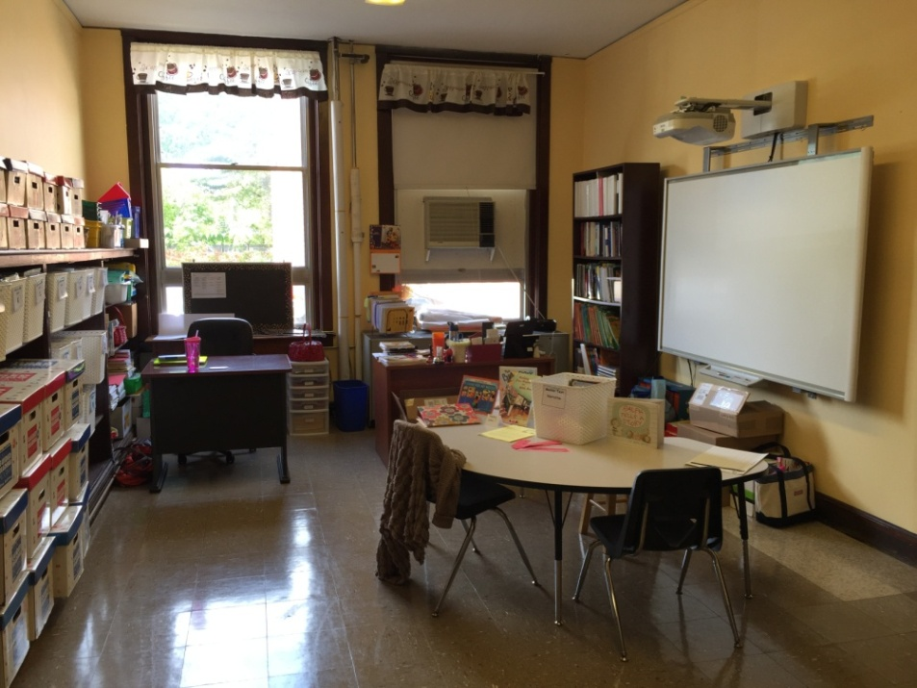
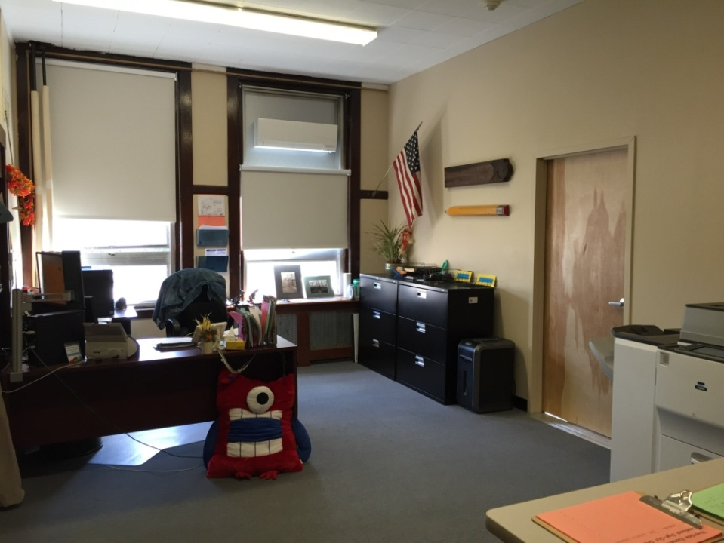
Riverdale SPED Improvements
*Teachers Room converted into Literacy Specialist room with SMART Board
*Main Office converted into reception and conference room for private SPED meetings

Slide 22
Facilities Staff -Contact Info
QUESTIONS?
Please feel free to contact the Facilities & Maintenance Department staff:
Denise Moroney, Director of Facilities
781-310-1141 office
781-752-7812 cell
Roger Lazdowsky, Facilities Operations Supervisor
781-310-1168 office
781-801-6825 cell
Barbara Smith, Facilities Clerk
781-310-1220 office

